Slide 1
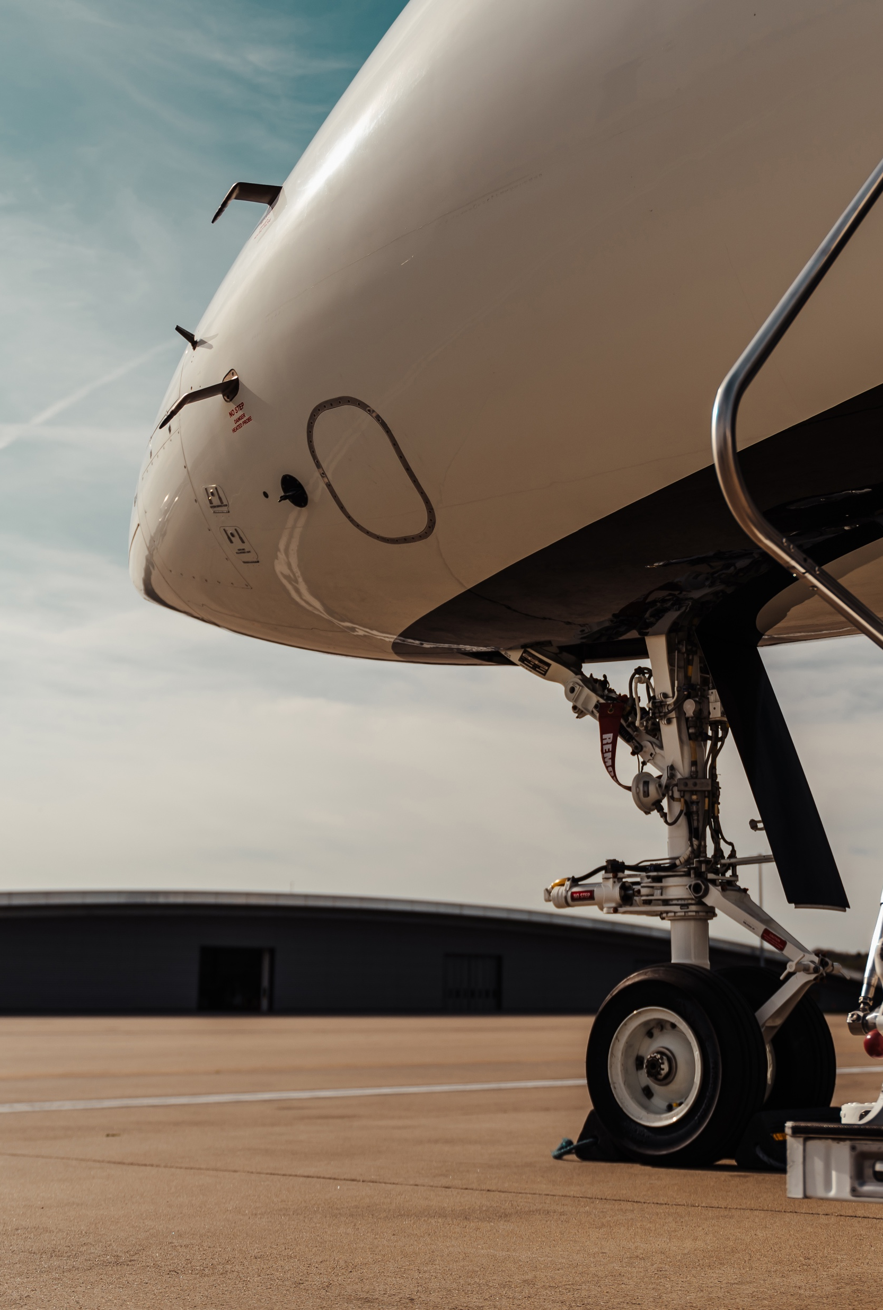
WHAT AIRCRAFT OWNERS ARE REALLY THINKING
Presented by: Simon Bambridge, Commercial Director - Asia

Slide 2


OBJECTIVES
Understand owner stance on the present by probing 5 key subjects.
Use this insight to better plan for 2026.

Slide 3
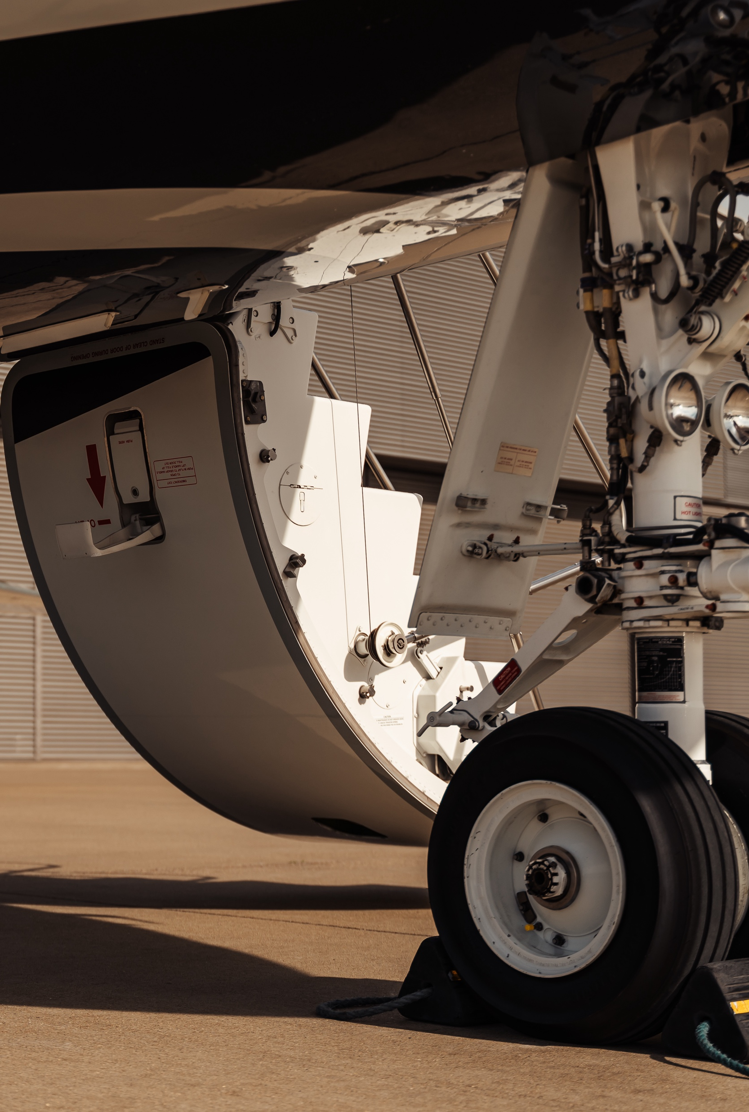
WHO DID TAG ASK?
30+ TAG Aircraft owners
Long time owners
First time owners
Corporate Owners
Answers were anonymous to promote openness
>90% response rate

Slide 4


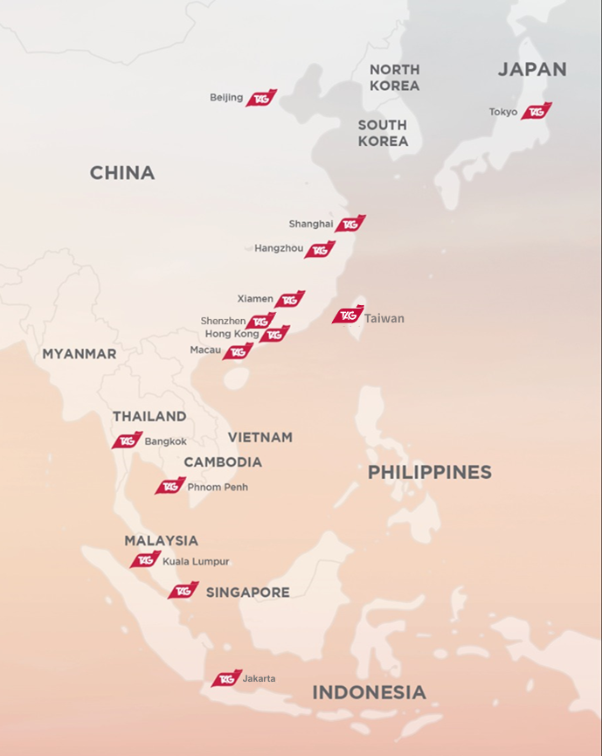
WHERE ARE THESE AIRCRAFT OWNERS BASED?

Slide 5

WHAT TOPICS DID TAG ASK?
Sustainability
Global geopolitics
Artificial Intelligence
Public image of Biz Av
Your Voice

Slide 6
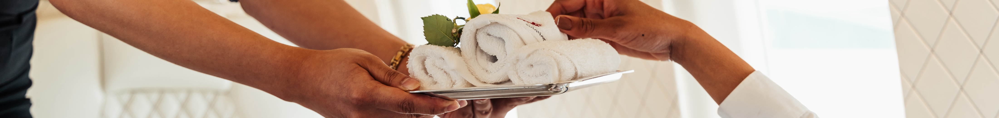

1. “WHAT ARE YOUR HONEST THOUGHTS ON
SUSTAINABILITY IN BUSINESS AVIATION?“
Yes 40% / 60% No
Is flying sustainably a priority?
If you could reliably offset all carbon by increasing your annual operating costs, would you?
Yes 38% / 62% No
If YES, by how much would you be willing to increase your annual operating cost?

Slide 7



2a. HOW HAS GLOBAL GEOPOLITICS LINKED
TO BIZ AV AFFECTED YOUR FLYING IN 2025?
Are geo-political & trade issues such as new tariffs impacting your flying?
Yes 38% / 62% No
If YES, has your flying increased or decreased?
91% decreased
Have overflight restrictions i.e. over Russia or the Middle East affected your usage?
Yes 28% / 72% No

Slide 8
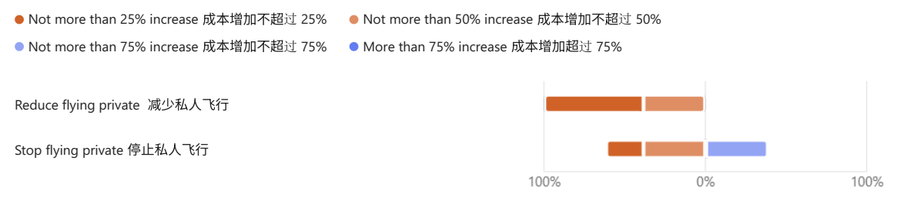
2b. HOW COULD GLOBAL GEOPOLITICS LINKED
TO BIZ AV AFFECT YOUR FLYING IN 2026?
Are you concerned that new taxes or regulation could significantly increase your operating cost or limit your areas of operations?
Yes 45% / 55% No
If YES, at what incremental cost would you consider reducing or even stopping your private flying?
62% 38%
23% 38.5% 38.5%

Slide 9

3. A.I. IN AVIATION, DO YOU FORESEE IMPROVEMENTS OR DO YOU NEED THE PERSONAL TOUCH?
Which areas do you think could be further improved through the use of AI?
What would you not be comfortable with?

Slide 10
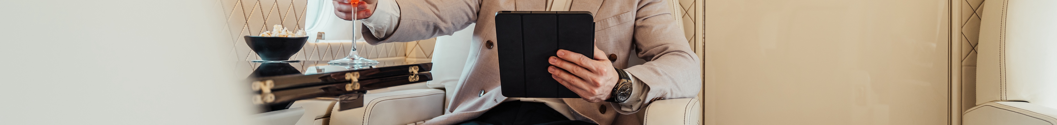
4. WHAT IS THE PUBLIC IMAGE OF BIZ AV AND IS THERE ANYTHING THE INDUSTRY NEEDS TO DO TO IMPROVE IT?
Do you think the public image of business aviation in Asia is positive or negative?
76 % Positive / 24% Negative
If positive, what recent changes have you noticed in how business aviation is being marketed or discussed in Asia?
Emphasis on business efficiency & accessibility
Government support for business aviation
If negative, or likely to become negative, then what do you want us (as an industry) to do about it?
Fight to promote the advantages
Ignore the negative press, it will have little effect on how I use my jet
Define a roadmap of how I can fly greener

Slide 11

5. WHAT DO YOU WANT TO SAY TO THIS AUDIENCE?
Mx downtimes
Parts failures
Lack of crew for new types
What are your frustrations with Biz Av?
“Supply chain inefficiencies is one, also higher price for aviation related products; eg starlink usage and installation.”
“机场时刻安排对延误了的公务机不友好, 飞机维修的时刻也要等很久
Airport schedules are not friendly to delayed business jets & aircraft maintenance requires a long wait.”

Slide 12
5. WHAT DO YOU WANT TO SAY TO THIS AUDIENCE?
Mx downtimes
Parts failures
Lack of crew for new types
What are your frustrations with Biz Av?
Aircraft hangarage
Optimisation of services
Leveraging technology
Do you see opportunities in Biz Av?
“Yes, to increased hangar capacity and reduce rental of the hangar”
“Optimize service and operational processes”
“Technologies bring better performance”

Slide 13
5. WHAT DO YOU WANT TO SAY TO THIS AUDIENCE?
Mx downtimes
Parts failures
Lack of crew for new types
What are your frustrations with Biz Av?
Aircraft hangarage
Optimisation of services
Leveraging technology
Do you see opportunities in Biz Av?
Will you ever leave Biz Av for commercial?
No

Slide 14

LOOKING AHEAD TO 2026
Find a green path that works
There is a place for AI but concerns abound
We need to keep promoting the benefits of Biz Av
We need to keep striving to improve the ownership experience

Slide 15
QUESTIONS?

Slide 16





THANK YOU
Simon Bambridge Commercial Director, Asia
TAG Aviation +65 8028 2378 / +852 6390 6101 sbambridge@tagaviation.com www.tagaviation.com

