Slide 1


















The ECA Option in Parallel:
Ensuring Deliveries On Time, Every Time
Notes:
Paul

Slide 2




You Tell Us
Who’s lost a deal or faced a significant delay in Asia due to the lack of financing or financing uncertainty?
Who has closed a deal with US Ex-Im Bank or with any other ECA in Asia?
Who thinks ECA financing is either
too slow or too hard?
AIRFINANCE

Slide 3









Myth 1: Only for airlines ❌
→ Reality: Closed jets/rotors globally ✅
Myth 2: Too slow ❌
→ Reality: Run in parallel; closes on delivery ✅
ECA MYTHS VS. REALITY
Myth 3: Inferior terms ❌
→ Reality: 85% LTV Max / 10 years term; finance lease or loan structure subject to deal size and credit; Cape Town discount ✅
Myth 4: Inflexible ❌
→ Reality: Work with qualified advisor who can make the process easier for you & deliver in difficult jurisdictions and your aircraft can get delivered on time✅
AIRFINANCE
Notes:
Paul asking Suha
3
‹#›

Slide 4
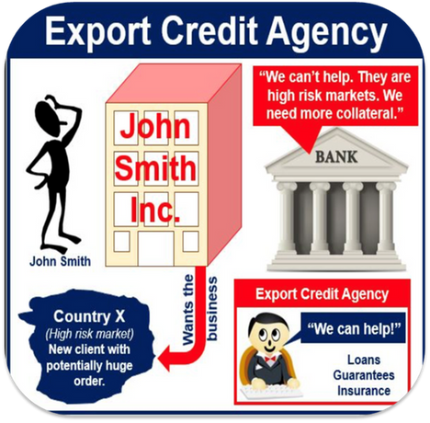
How do ECA’s work and
what are they looking for?
1) Is it the cheapest aircraft finance available?
Often very competitive - sometimes the cheapest, but not always. The government guarantee typically lowers bank risk spreads and may allow longer tenors, which reduces periodic debt service.
Bottom line: compare total cost (rate + fees + tenor + covenants + timeline) against bank offers rather than assuming ECA is always the cheapest.
2) What are export credit agencies looking for?
Eligible export content & policy fit. EXIM’s mission ties to U.S. jobs; transactions must meet U.S. content rules (with specific thresholds by program) and policy limits.
3) Is it worth the effort?
Yes, when you need cross-border depth, tenor, and resilience. ECA support shines for emerging-market operators, cross-border borrowers, or when local bank liquidity is tight - and recent US EXIM activity in SE Asia underscores ongoing support for aircraft exports.
AIRFINANCE

Slide 5
Summary Table for Export Credit for Business Jets & Helicopters
Feature | Assessment for Business Jets & Helicopters
Cheapest? | Among the lowest for emerging markets
Requirements | 3 Y of audited financials, must be an operating company not an individual or pure holding co; extensive credit / risk review
Processing time | 4-6 months, engage us early – depending on aircraft type and whether it is a loan or finance lease structure
Best suited for | Corporate buyers in challenging jurisdictions, who can’t access bank finance or corporate buyer who wants to diversify borrowing base
Documentation | Heavy documentation – therefore, work with experienced legal counsels; process heavy but reliable
Structure | Usually, SPV structure (finance lease) – SPV acts as the owner, borrower and lessor
When worth it? | The value is clearest a) when private sector options are insufficient, expensive or unwilling to lend; b) when private liquidity fades, ECAs step in to act as stabilizing agents and promote global economic stability

Slide 6



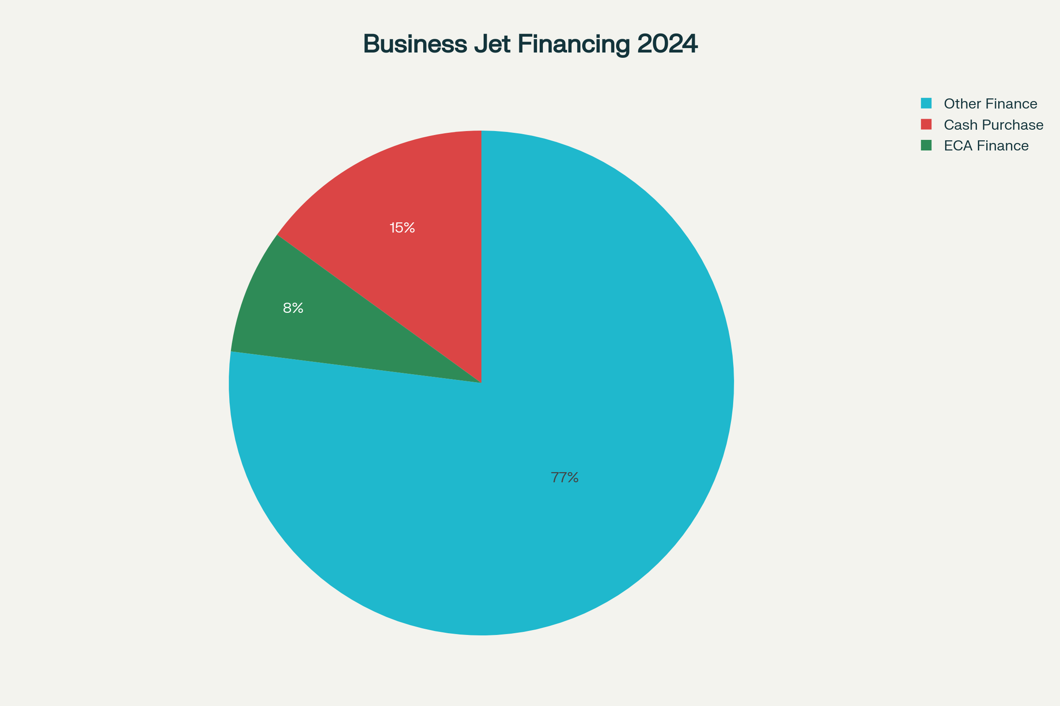
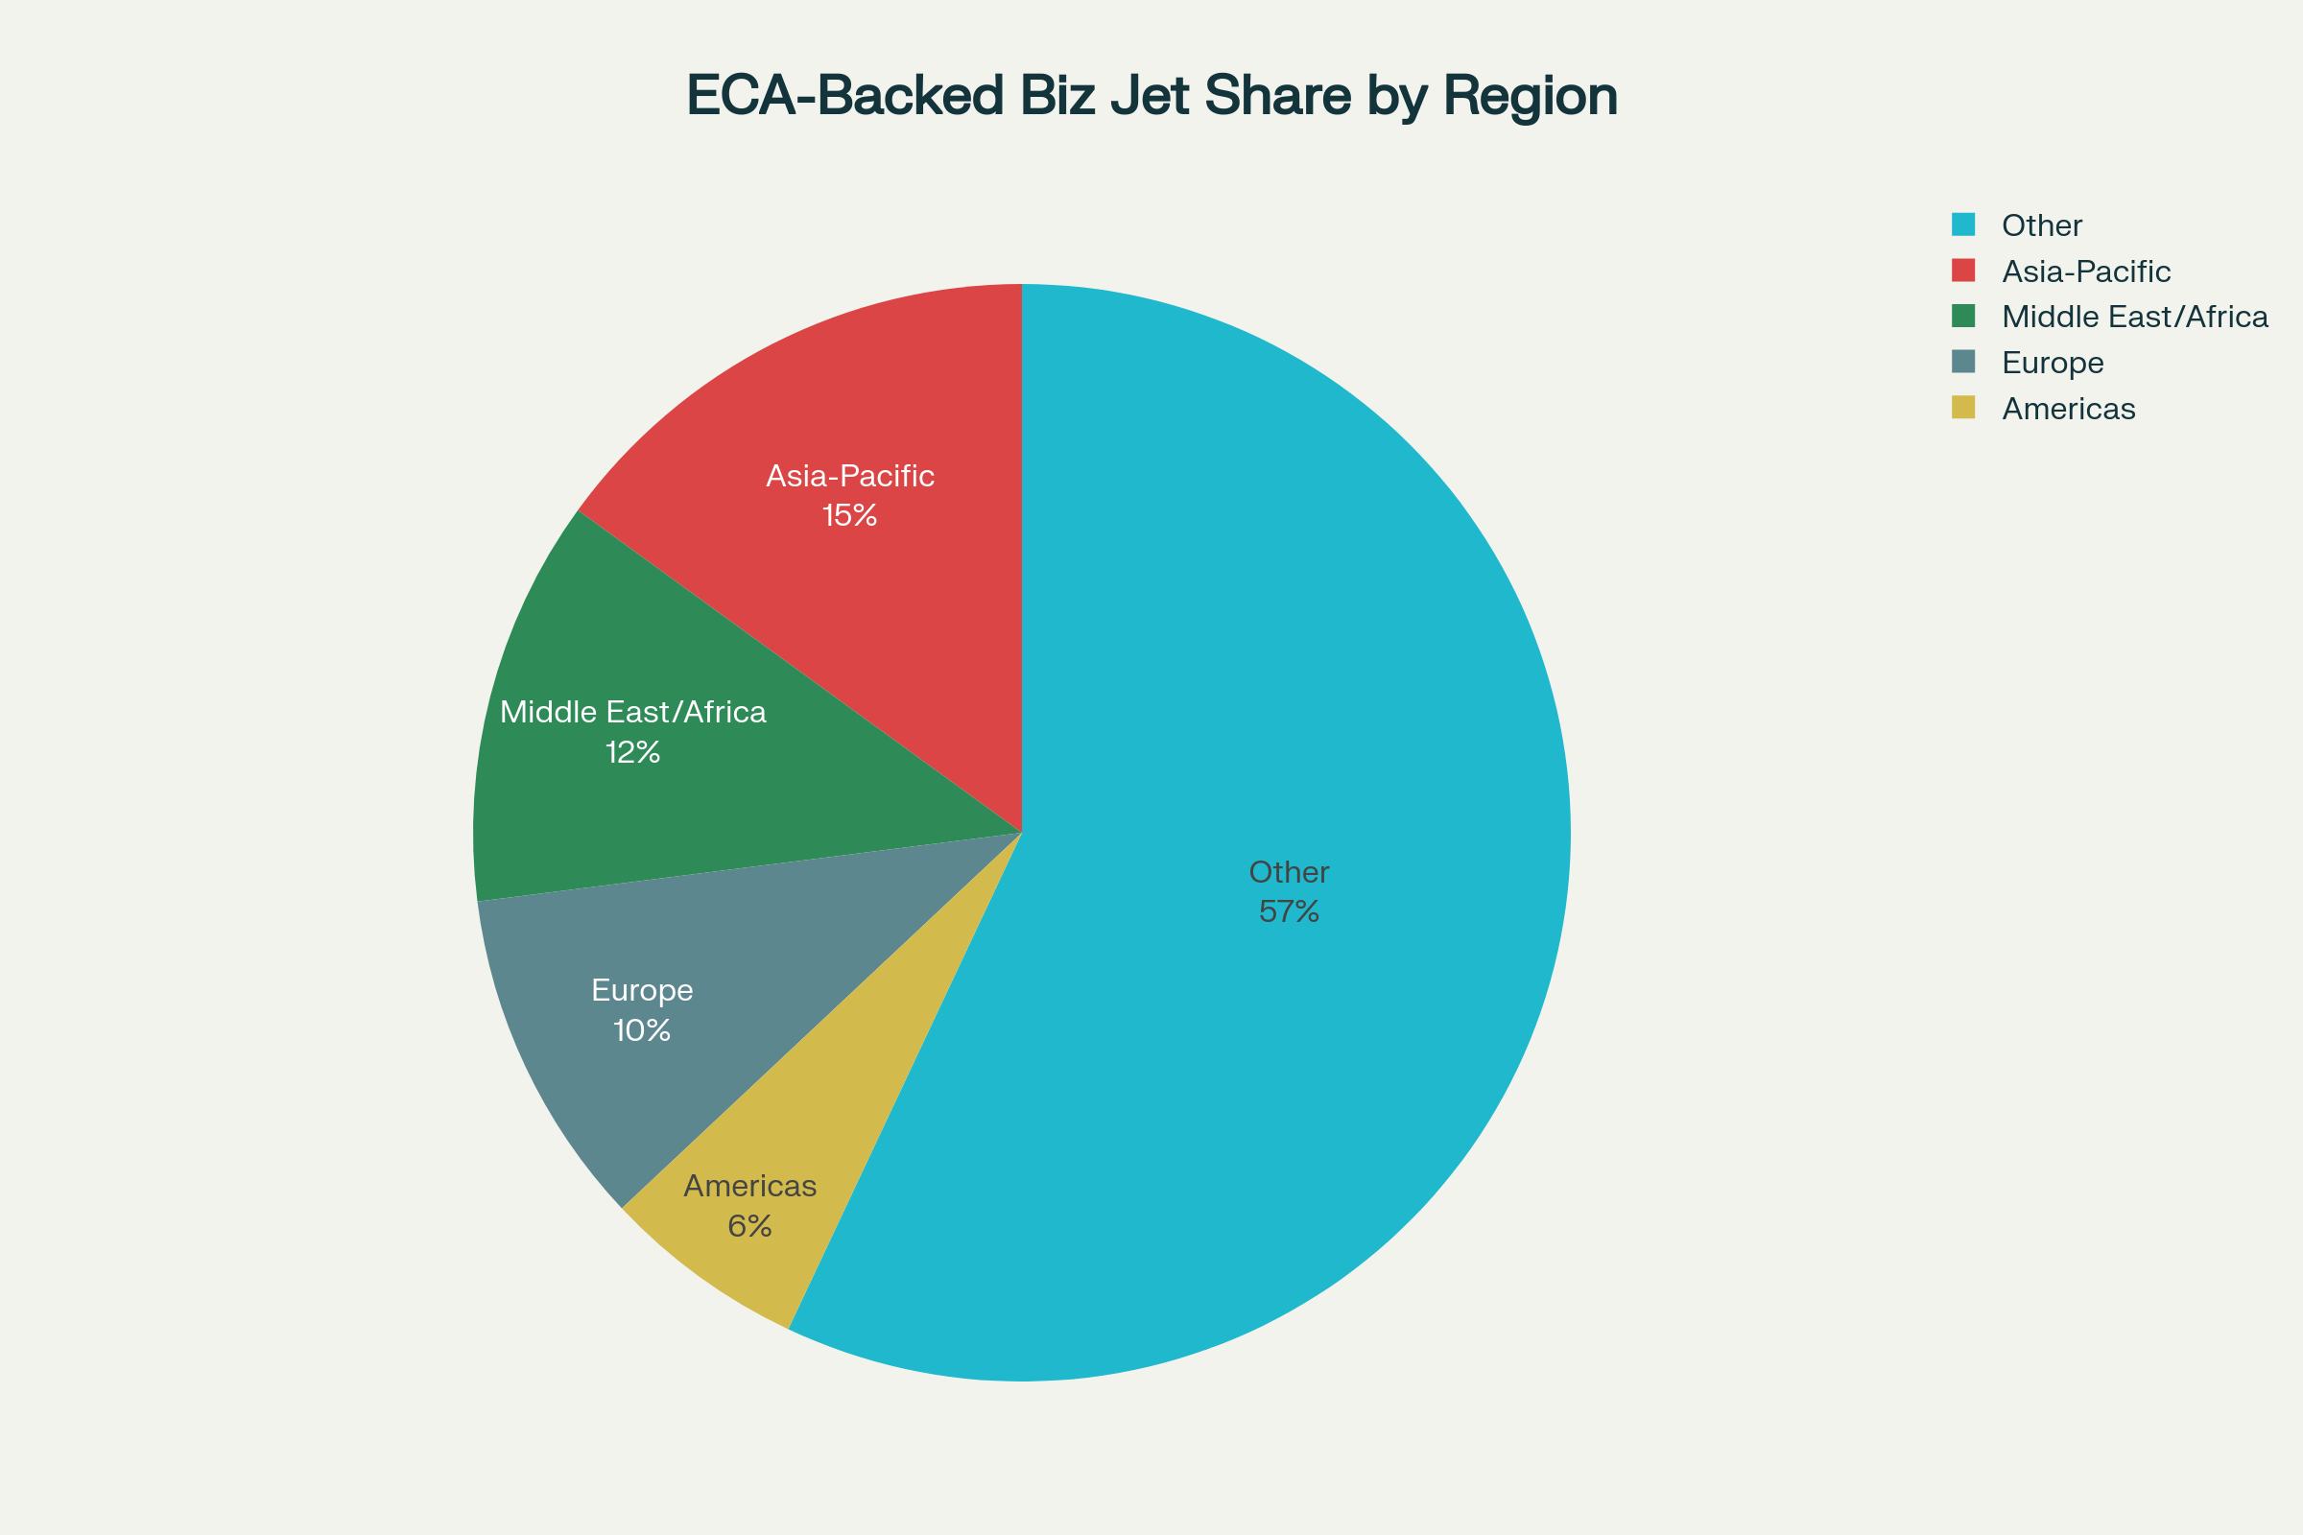







Cash
Funding Sources Breakdown - 2024
Approx. 730 “New” Business Jets Sold World
Bank Debt
Lessors / Private Finance Companies
Export
Credit
AIRFINANCE

Slide 7
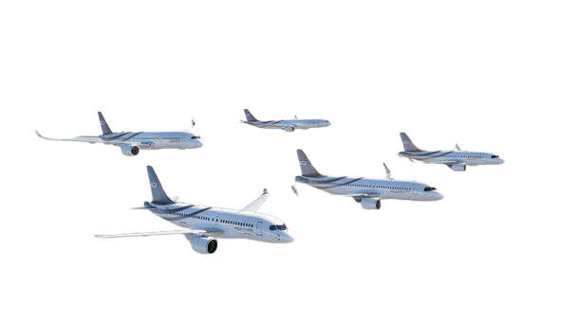
Cases in Point: ASIA
Local banks have no appetite / country risk
    → use ECA financing to have access to long term capital
From previous slide: ECA share is highest in Asia, due to greater country risk, unrated sponsors, and limited access to local funding, many buyers rely on ECA support for delivery certainty
Examples
  An initial deal for a single large-cabin business jet grew into financing three aircraft for the same client over 3 years, all supported by US Exim Bank guarantees.
  A relationship that began with financing one caravan through US Exim guarantee grew to support the acquisition of seven caravans for a medium-sized operator in Indonesia.
  Mongolia is a notable case where an Airbus helicopter was financed successfully with support from Germany’s export credit agency, Hermes.
AIRFINANCE

Slide 8

Run the ECA Option in Parallel. Deliver on Time
Reframe: ECA isn’t subsidy –
it’s risk transfer for non-payment, default, or political instability from exporters and their banks to the ECA +
enabling cross-border projects to proceed with confidence and “financial predictability”
Parallel path: Start at LOI → creates leverage on commercial pricing.
No delivery delays.
Financing certainty: stakeholders retain more options without having lost precious time.
Positioning for
Early Engagement
Asia tie‑in: When country risk + unrated sponsors meet delivery deadlines, often the ECA lane is the only lane.
Proof of execution: > $1B+ in EXIM bizjets/helicopters; AirFinance + EXIM Lender of the Year.
AIRFINANCE

