Slide 1
The Great Ultra-High Net Worth Migration
Oct 2025
Notes:
Today, I am pleased to be giving you a first look at the latest findings from the The Henley Private Wealth Migration Report 2025 which was just published today. This is an annual report produced by Henley & Partners, in partnership with global wealth intelligence firm New World Wealth.

Slide 2
About Henley & Partners

Slide 3


We Advise Private Clients and Governments
Private Client Services
Government Advisory Services
Helping high-net-worth individuals and entrepreneurs to acquire one or more alternative residences and/or citizenships around the world
Strategic consulting, design, set-up, operation, and promotion of residence and citizenship programs for countries worldwide
Residence and Citizenship advisory
Real Estate
Education
Concierge
Residence and Citizenship program design
Program set-up and operation
Application processing and due diligence
Global positioning and promotion
Over 70 offices worldwide, leading the sector for over 25 years
Raised over USD 15 billion in foreign direct investment

Slide 4
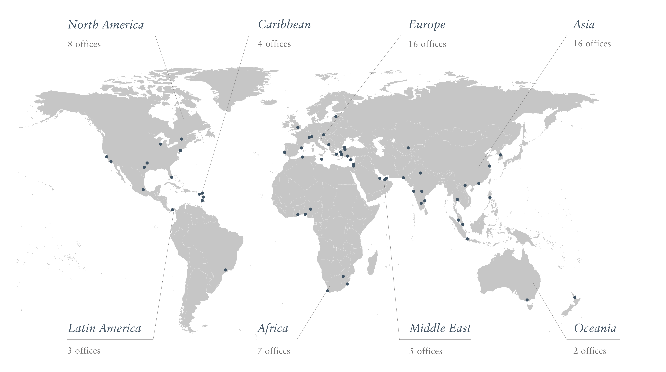
Global Presence — Over 70 Offices Worldwide

Slide 5
The Henley Private Wealth Migration Report

Slide 6
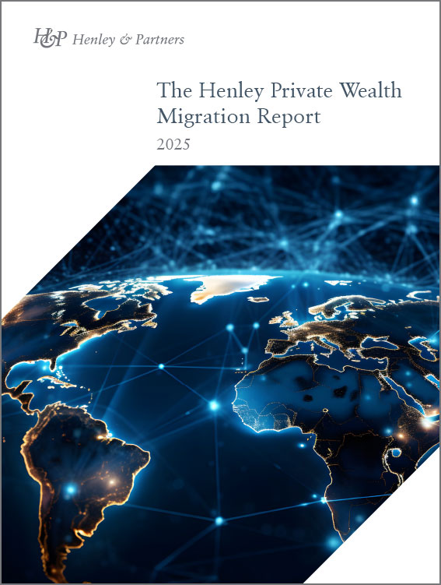
Hot Off the Press: Henley Private Wealth Migration Report 2025
Published by Henley & Partners in partnership with New World Wealth, the Henley Private Wealth Migration Report 2025 is a compelling publication for followers of wealth and investment migration trends — whether global citizens, investors, wealth managers, or private bankers
The report features global wealth and investment migration trends and offers expert insights and unique data on millionaire migration worldwide
Discover the top countries for projected net inflows and outflows of millionaires, the 10 fastest growing wealth markets, and the world’s 10 wealthiest nations (W10)
Notes:
This report features global wealth and investment migration trends highlighting the top countries for projected net inflows and outflows of millionaires, the fastest growing wealth markets, and the world’s 10 wealthiest nations – what we refer to as the W10.
Most HNWIs migrate through the acquisition of work, ancestry, retirement or family visas or by birthright second citizenships – around 30% opt for investment migration programs to secure alternative residence rights or additional citizenships.

Slide 7

Millionaires on the Move
142,000
Provisional worldwide millionaire migration in 2025
UAE Biggest millionaire inflow in 2025
UK Biggest millionaire outflow in 2025
Notes:
Millionaires are more on the move than ever before – the numbers we’ll be talking about in the next hour are those individuals with liquid investable wealth of USD 1 million or more that relocate to another jurisdiction for more than 6 months – which then also impacts their tax residence, hence why we have Peter joining us as our resident tax expert.
Liquid investable wealth includes listed company holdings, cash, bonds, gold, and crypto holdings. Real estate assets are excluded.
In 2025, a record-breaking 142,000 millionaires are projected to relocate internationally.
The UAE is expected to again be the number one recipient of these migrating millionaires globally and for the first time the UK is forecast to top the millionaire outflow list.

Slide 8
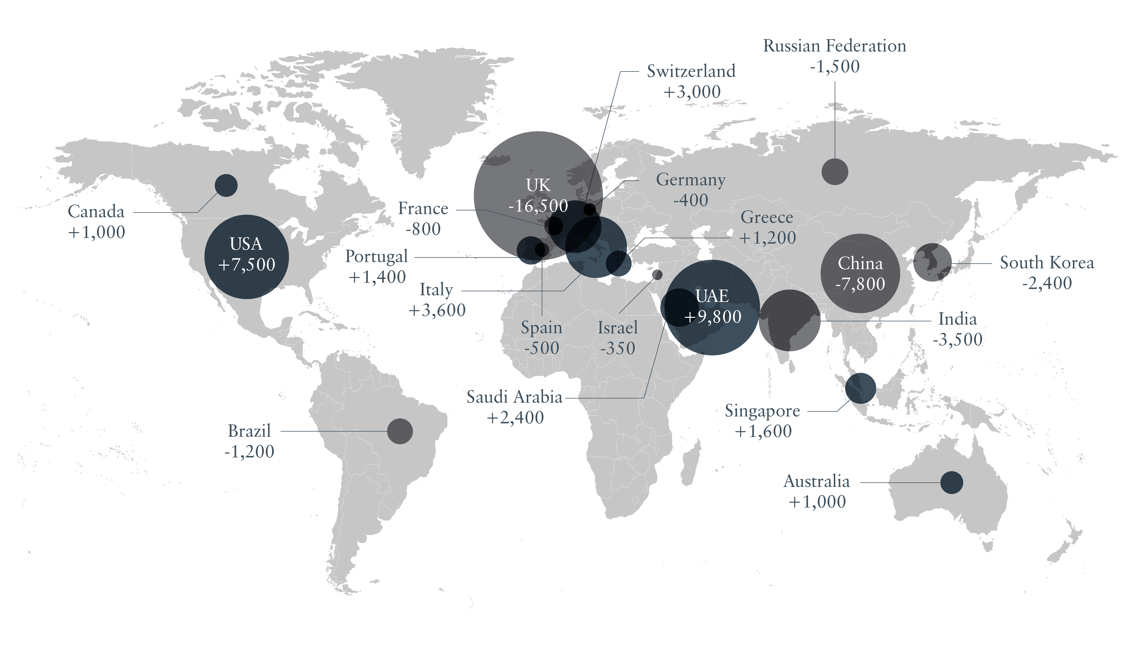
Top 10 Countries Gaining and Losing Millionaires in 2025
Source: New World Wealth

Slide 9
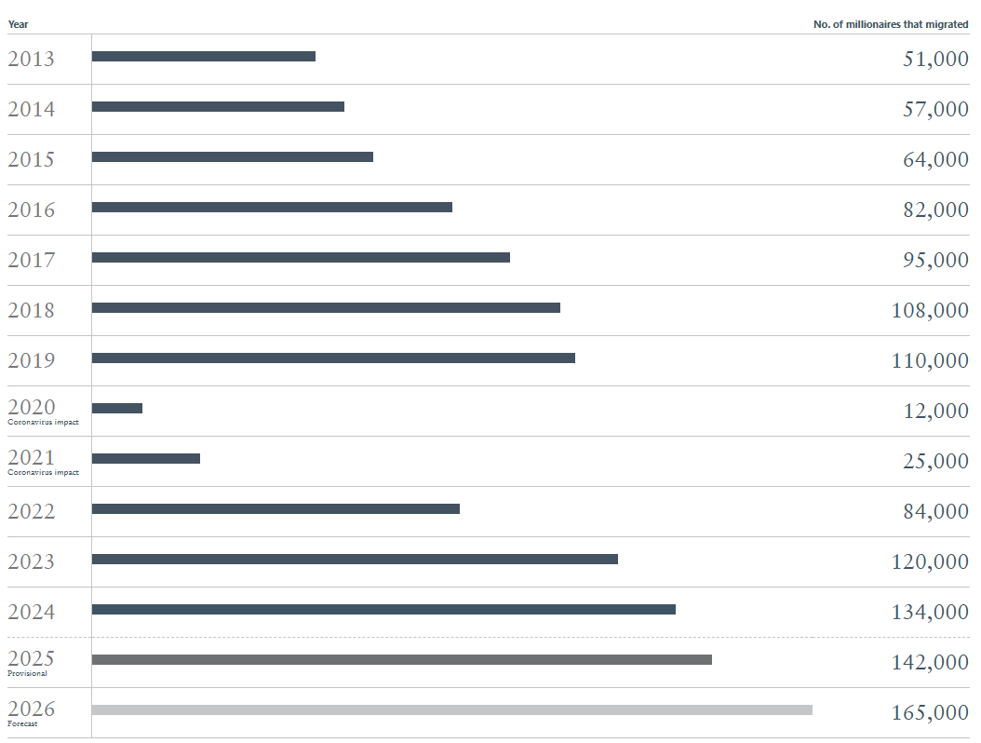
The Great Wealth Flight: Millionaires Relocate in Record Numbers
142,000 millionaires are expected to relocate internationally in 2025 — a record-breaking number
Projections indicate this figure could rise to 165,000 in 2026
This marks the largest voluntary transfer of private capital in modern history
Source: New World Wealth
Notes:
142,000 millionaires are expected to relocate internationally in 2025 — a record-breaking number
Projections indicate this figure could rise to 165,000 in 2026
This marks the largest voluntary transfer of private capital in modern history
Wealth migration signals a global shift in economic power, not just a demographic trend
Countries are racing to attract both talent and capital, reshaping financial hubs and prosperity zones
The future of global wealth flows depends on how well countries address the complex mix of economic, political, and lifestyle drivers behind relocation decisions

Slide 10
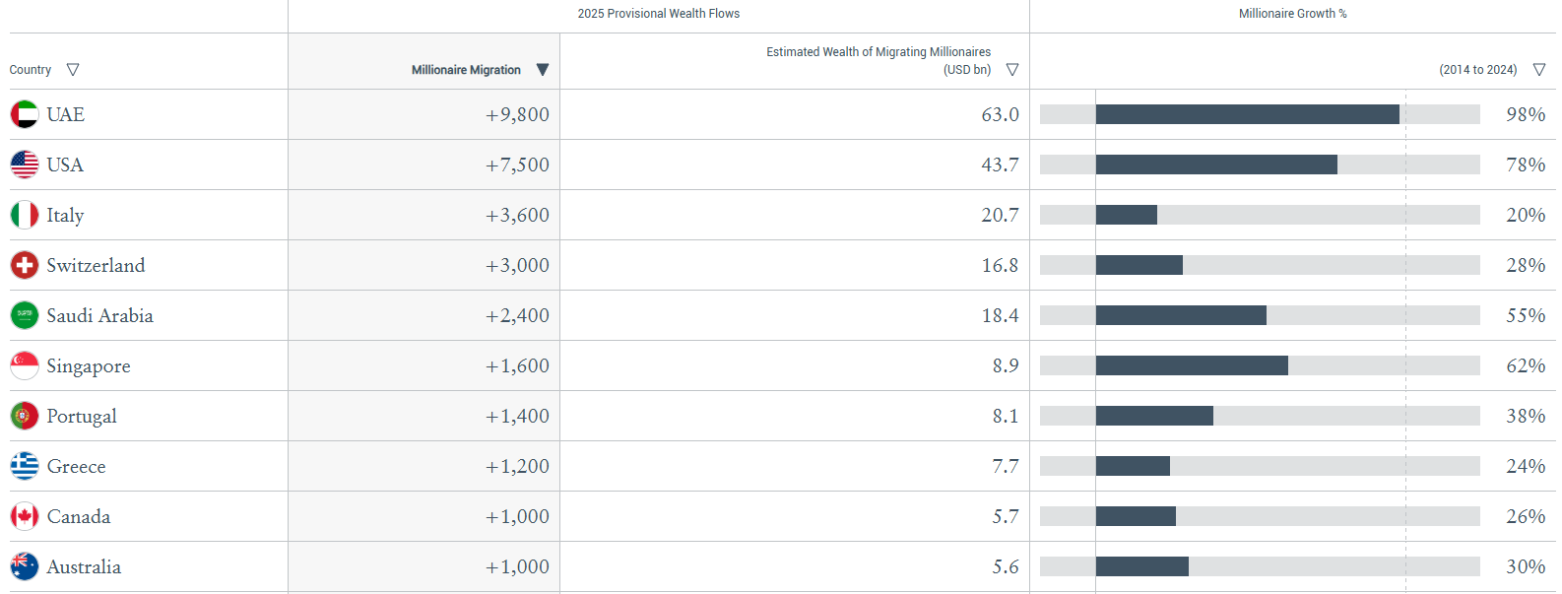
Top 10 Countries for Net Millionaire Inflows in 2025
Source: New World Wealth
Notes:
The UAE is expected to attract 9,800 millionaires in 2025, bringing in USD 63 billion in investable wealth, marking a shift from regional hub to global wealth nexus
The UAE’s success is driven by zero personal income tax, political stability, world-class infrastructure, and capital-friendly regulation, not just immigration policy
It’s Golden Visa program (launched in 2019 and expanded in 2022) offers 5- and 10-year visas tied to property, business, and talent attraction
Strong inflows coming from the UK, India, Russia, the Middle East, Africa, Southeast Asia and China.
The USA is set to gain 7,500 millionaires in 2025, driven by its entrepreneurial ecosystem and reputation for economic opportunity despite lacking major tax incentives
The EB-5 Investor Program has brought in USD 50 billion+ in FDI since 1990 and created hundreds of thousands of jobs, reflecting the enduring appeal of US growth potential
The proposed Gold Card aims to further attract ultra-HNWIs, acknowledging the growing global competition for wealth
At the same time, outbound wealth is rising — Americans now account for over 30% of Henley & Partners' 2025 applications, a 200% increase vs Q1 2024, driven by political volatility and demand for global mobility
Strong inflows from Asia, Latin America and the UK.
Florida is especially popular, whilst Silicon Valley remains the world’s top destination for wealthy tech entrepreneurs.
Some are leaving the USA – mainly older HNWIs moving to retirement hotspots such as Portugal, Costa Rica and the Caribbean.
Traditional destinations attracting the wealthy such as Singapore, Australia, Canada, New Zealand and Spain appear to be losing their appeal showing the lowest inflows on record.
Italy continues to attract record numbers of HNWIs, mainly from other European countries such as France, the UK and Switzerland with taxes being a significant factor here.
Switzerland continues to be popular, especially with ultra-wealthy centi-millionaires & billionaires from the UK and Scandinavia – Zug, Geneva and Lugano all remain very popular destinations.
Saudi Arabia is the big riser on this year’s list – attracting record numbers of HNWIs – boosted by strong inflows from the UK, North Africa and the Middle East.
The ones coming from the UK are mainly Saudi born HNWIs that were living in the UK (possibly non-doms) and are now returning primarily to Riyadh and Jeddah.
Singapore is seeing smaller than usual HNWI inflows in 2025 – some wealthy expats preferring to park their money in emerging financial hubs such as the UAE. Family office growth has also slowed in Singapore.
Portugal and Greece are both among the top 10 destinations – Lisbon and the Algarve are extremely popular as well as the Athenian Riviera and the Greek Islands.
It’s also interesting to note that the majority of the world's fastest growing wealth markets over the past decade are those that have investment migration pathways and have therefore been heavily aided by inward wealth migration.

Slide 11










All Top 10 Countries for Net Millionaire Inflows in 2025 Host Investment Migration Programs
Canada Start-Up Visa Program
Italy Residence by Investment Program
Greece Golden Visa Program
UAE Residence by Investment
Singapore Global Investor Program
US EB-5 Immigrant Investor Program
Portugal Golden Residence Permit Program
Swiss Residence Program
Saudi Premium Residence
Australia National
Innovation Visa Program
Notes:
The slide illustrates the Top 10 countries seeing inflows and their investment migration programs, however all Top 20 destinations for projected net inflows of millionaires in 2025 actually operate investment-based residence programs
KSA has a Premium Residency (Saudi Green Card) with unlimited duration at $210,000 and a one-year renewable option at $26,660 annually as well as an Investor Visa Program for real estate $1.1m or a business investment of $1.9m and hiring at least ten employees.
Japan has an Investor/Business Manager Visa – not a passive golden visa with certain requirements and requires active business ownership and operation.

Slide 12
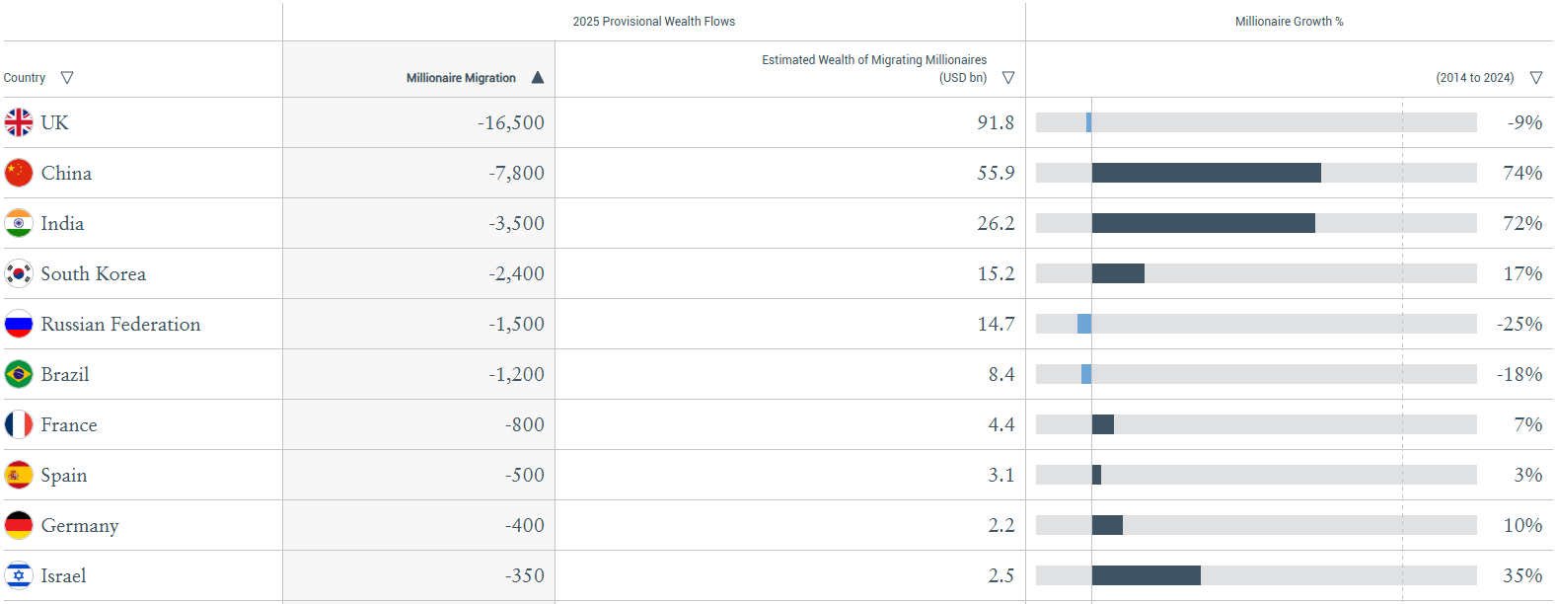
Top 10 Countries for Net Millionaire Outflows in 2025
Source: New World Wealth
Notes:
The UK is again the big story this year and is set to lose 16,500 millionaires in 2025, with USD 92 billion in assets leaving — the largest single-year outflow ever, following 10,800 departures in 2024
This marks the first time in 10 years that the UK tops the millionaire outflow list
UK applications for alternative residence and citizenship surged 183% for us in Q1 2025, making it the 6th-largest global source of investment migration
China is to see a net outflow of 7,800 millionaires in 2025, but this marks its lowest level in years, signaling a potential turning point
This stabilization is driven by China’s booming tech hubs in Shenzhen and Hangzhou and strong growth in the private banking, healthcare, and entertainment sectors
Unlike other major economies, China has no investment migration program, relying primarily on domestic wealth creation — second only to the USA in millionaire generation over the past decade
Despite outflows, Chinese nationals remain among the top 10 for global investment migration demand
Part of a broader BRICS rebound, China, India, and South Africa are forecast to post their lowest outflows on record
South Africa and India are being aided by the ongoing return of HNWIs from the UK
For the first time all three EU powerhouses (France, Spain and Germany) face net HNWI losses in the same year which reflects a worrying trend of growing millionaire outflows across Western and Northern Europe
Spain and France are both expected to lose large numbers of HNWIs as taxes have been rising there – both countries now have very high estate duty and capital gains tax by global standards.
Germany is also beginning to lose large numbers of HNWIs – its tech, automotive and financial sector has been struggling to keep pace with the USA and Asia and their source of cheap gas from Russia has also been shut down since 2022.
Large outflows are also projected from Korea in 2025, following a tough past couple years economically and politically and exceptionally high inheritance taxes
Israel is still seeing outflows, mainly to the USA, however, these outflows are lower even when considering the ongoing conflict in the region. Israel’s resilience may be explained by it being the only country in the world with a Jewish majority.

Slide 13
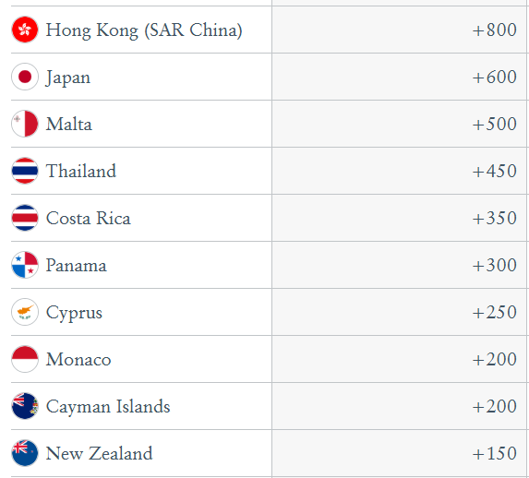
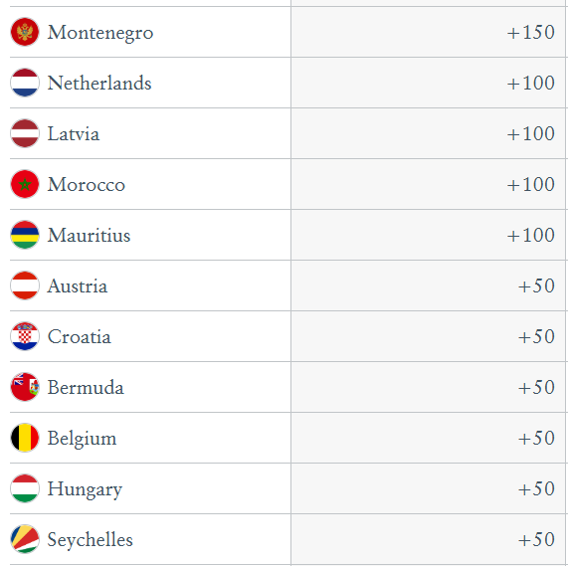
Other Countries with Net Millionaire Inflows in 2025
Source: New World Wealth
Notes:
Inflows are largely driven by:
Favorable tax regimes, strong lifestyle appeal, active investment migration programs
Hong Kong starting to see some solid inflows from the rest of Asia – many of the top earning execs of fast-growing Shenzhen based hi-tech companies are now basing themselves in Hong Kong.
Monaco is projected to attract +200 millionaires, remaining a top destination for UHNWIs from the UK, Africa, and the Middle East – naturally its small size and the high price of property there limits potential inflows.
Southern Europe is rapidly emerging as a new center of gravity for wealth migration in the region
Japan is attracting large numbers of HNWIs from China.
Malta continues to be popular destination for HNWIs especially from the UK with its fast growing tech and financial sector, and low tax rates compared to the rest of the EU.
Thailand is becoming increasingly popular with HNWIs from China, Vietnam and Korea.
Caribbean & Latam destinations such as Panama, Costa Rica, Cayman Islands and Bermuda are all expected to record record inflows in 2025.
Cyprus and Montenegro are both especially popular among HNWIs from the Middle East, Africa, Russia, Ukraine & CIS. Notably, Montenegro is the fastest growing wealth market in the world over the past decade mainly due to inward wealth migration.

Slide 14
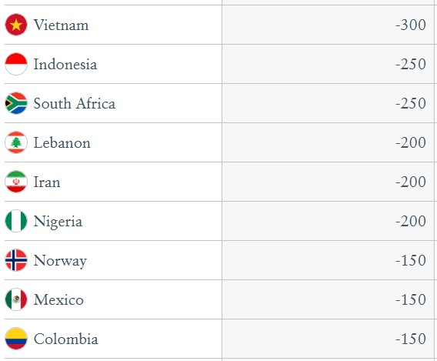
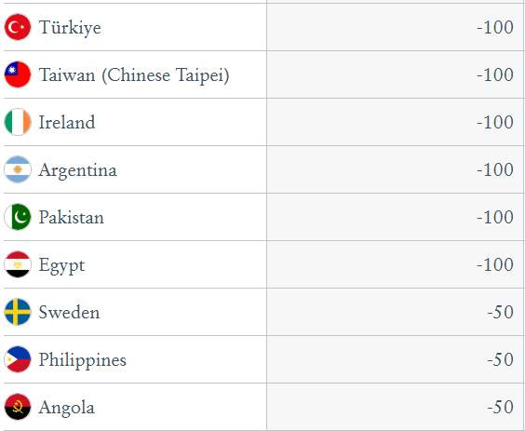
Other Countries with Net Millionaire Outflows in 2025
Source: New World Wealth
Notes:
Vietnam is starting to lose large numbers of HNWIs with most moving to Thailand, the USA, Canada and Australia.
Lebanon is losing significant numbers with many moving to Cyprus, Greece and the UAE.
Pakistan and Iran also continue to lose large numbers of HNWIs, mainly to the UAE.
In Latam, Brazil and Colombia both see big outflows with popular destinations including the USA (Florida especially), Portugal, the Cayman Islands, Costa Rica and Panama.

Slide 15
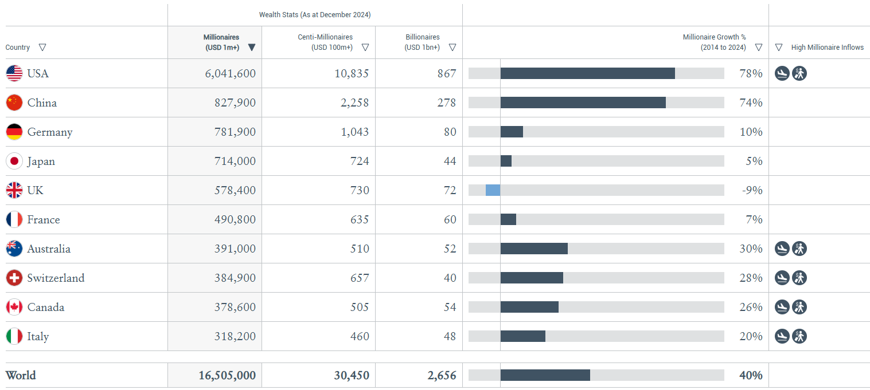
The World’s Top 10 Wealthiest Countries: The W10
The W10 refers to the 10 wealthiest countries in the world when ranked by number of resident millionaires
Source: New World Wealth
Notes:
The W10 refers to the 10 wealthiest countries in the world when ranked by the number of resident millionaires with liquid investable wealth of USD 1 million or more.
Over the past 10 years, the US has surged ahead in wealth generation. From 2014 to 2024, the country’s millionaire population grew by 78%, slightly outpacing China’s 74%, and significantly exceeding growth in other nations. Top of the W10, America now boasts approximately 6m millionaires, 10,800 centi-millionaires, and over 850 billionaires. China follows with around 830k millionaires, 2,250 centi-millionaires, and about 280 billionaires, significantly trailing when it comes to private wealth numbers despite its rapid growth.
In contrast, other major W10 economies have shown markedly slower growth.
Germany’s millionaire population increased by just 10% over the past decade, Japan’s by 5%, and, notably, the UK’s shrank by -9%, suggesting significant millionaire flight and economic stagnation.
Australia (+30%), Switzerland (+28%), Canada (+26%), and Italy (+20%) performed better, although they all lag far behind the US in absolute millionaire numbers and wealth growth rates.
In 2024 alone, the USA attracted approximately 3,800 high-net-worth individuals, 95 centi-millionaires, and 10 billionaires — the latter two being particularly significant as these individuals are typically company founders and entrepreneurs. We anticipate this number will be significantly higher in 2025.

Slide 16
Reasons for an Alternative Residence
Quality of life
Better safety, personal security, and environment
Better healthcare and transport systems
Security
Safe alternative in times of instability
Defined legal environment and banking privacy
Education
Access to high-ranking schools and language skills, which are essential for a successful career
Taxes
To relocate is often the only way to reduce tax burden and regulatory restrictions

Slide 17
Reasons for a Second or Alternate Citizenship
Visa waivers & Mobility
Travel to countries previously restricted by time-consuming visa application processes
Freedom of movement when exposed to physical or financial threats
Opportunities & Retirement
Access to better business, education, and healthcare opportunities in other countries
Freedom to retire in a safe country without worrying about changing immigration laws
Independence & Expatriation
Ability to travel or have the option to relocate at any time
Becoming a citizen of a country with more favourable conditions
Optionality in times of conscription
Protection & Security
Improved physical and personal security for you and your family
Guarantees the right to a permanent alternative destination in which to reside

Slide 18
Top 10 Nationalities for Enquiries Submitted to Henley & Partners
2018 | 2019 | 2020 | 2021 | 2022 | 2023 | 2024
1. India | 1. India | 1. India | 1. India | 1. USA | India | USA
2. Pakistan | 2. South Africa | 2. USA | 2. USA | 2. India | 2. USA | 2. India
3. South Africa | 3. Bangladesh | 3. Pakistan | 3. South Africa | 3. Nigeria | 3. Pakistan | 3. Pakistan
4. USA | 4. Pakistan | 4. Nigeria | 4. UK | 4. Pakistan | 4. Bangladesh | 4. UK
5. Bangladesh | 5. Nigeria | 5. South Africa | 5. Pakistan | 5. UK | 5. UK | 5. Nigeria
6. UK | 6. USA | 6. UK | 6. Nigeria | 6. Bangladesh | 6. Nigeria | 6. Bangladesh
7. Egypt | 7. UK | 7. Bangladesh | 7. Bangladesh | 7. South Africa | 7. South Africa | 7. South Africa
8. Nigeria | 8. Egypt | 8. Lebanon | 8. Sri Lanka | 8. Canada | 8. Türkiye | 8. Egypt
9. China | 9. Sri Lanka | 9. Iran | 9. Canada | 9. China | 9. Canada | 9. Canada
10. Iran | 10. Lebanon | 10. Egypt | 10. Lebanon | 10. Australia | 10. Nepal | 10. Algeria

Slide 19






Building Resilient Wealth Across Generations
“It’s a case of not putting all your eggs in one basket.”
Hedging against country-specific risk and global volatility
Mobility as an alternate and strategic asset class
Building entrepreneurial resilience for your business
Improving the resilience of portfolios and ensure physical and financial longevity
Accessing alternative business, career, educational, healthcare, and lifestyle opportunities
Futureproofing your family by providing them with access to multiple jurisdictions across the globe

Slide 20
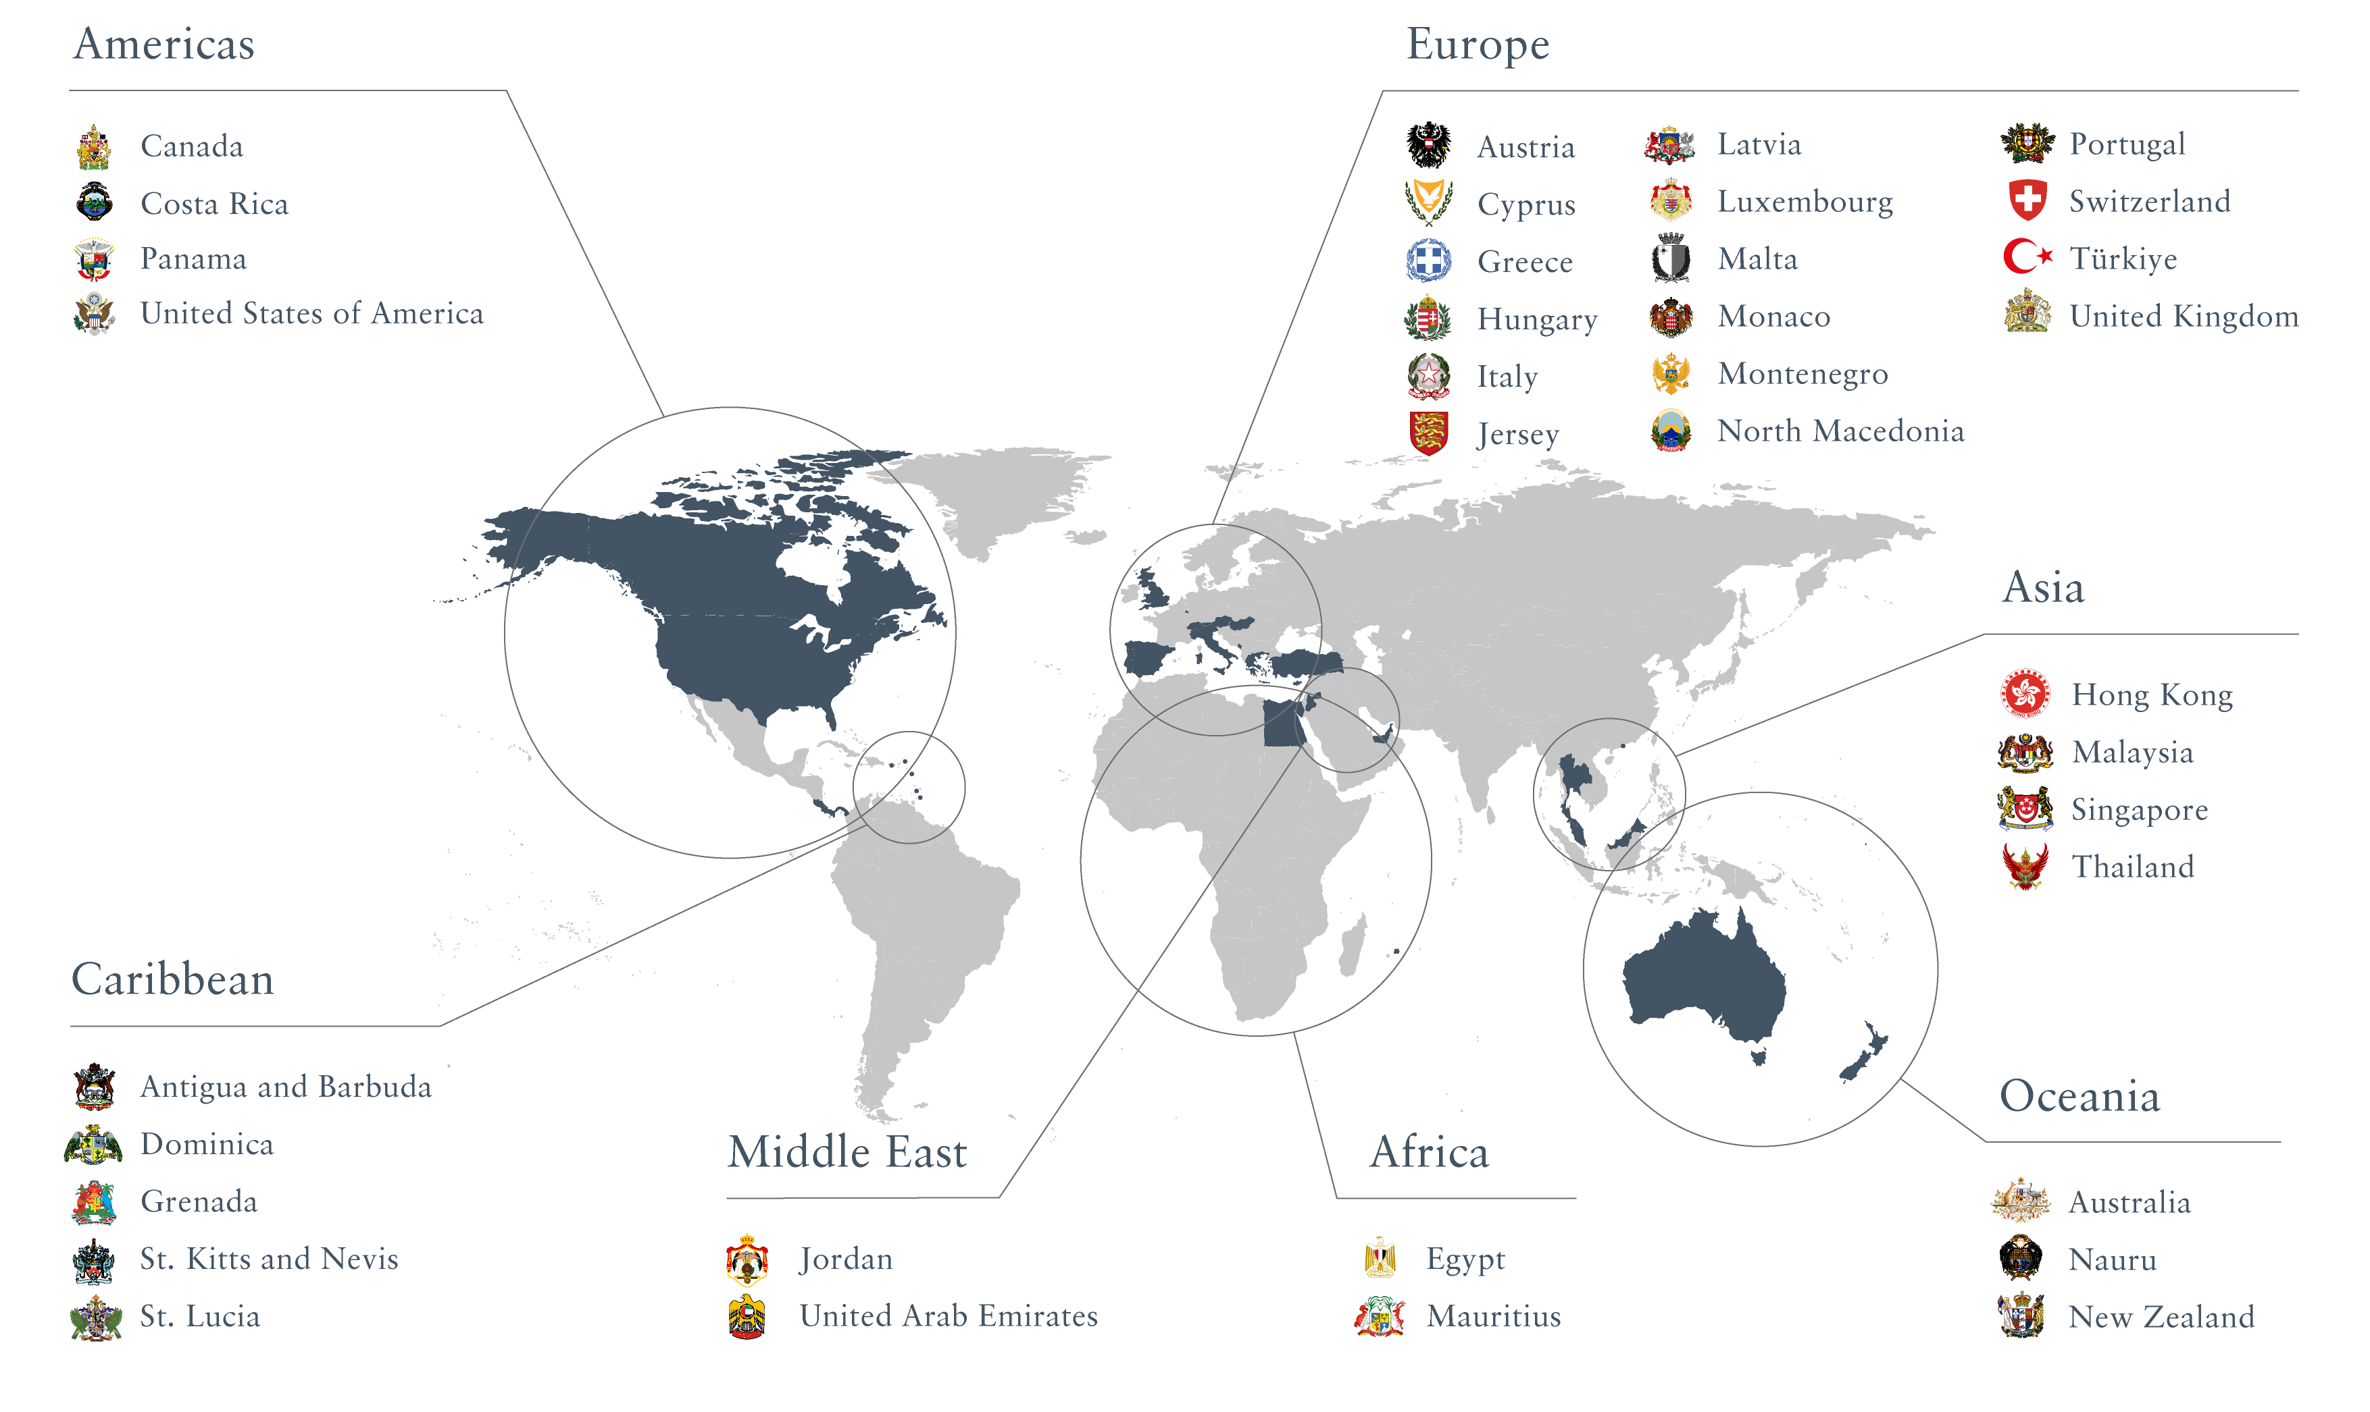
Leading Residence and Citizenship Programs
Notes:
As mentioned earlier, around 30% of migrating millionaires use investment migration programs to secure alternative residence rights or additional citizenships.

Slide 21





Contact Us
Rory McDaid
Managing Director, Private Clients
Henley & Partners Singapore Pte. Ltd. PLUS Building
20 Cecil Street Level 03-03/04 Singapore 049707
Telephone +65 9271 2771 rory.mcdaid@henleyglobal.com

