Slide 1


Identify Opportunities in the APAC Business Aviation Market 2025
By Alex Jiao, Chairman of Hongkong Jet

Slide 2

Summary Recap
of YE 2022 - YE 2024
Market Opportunity
APAC market has witnessed a slight increase
Mainland China holds the largest market share in APAC; although the number has declined during the past years
New markets in Southeast Asia are gaining prominence
Ownership in Mainland China, Hong Kong SAR and Malaysia has declined for the last 4 years
Fleet Number
The overall figures “dipped” from a previous peak, however we expect an uptick
Flight Activity
Strong trend and growth in Short-haul / domestic flights
Jet Size
Increased demand for light and large jets, nevertheless long range jets still remain favorable

Slide 3
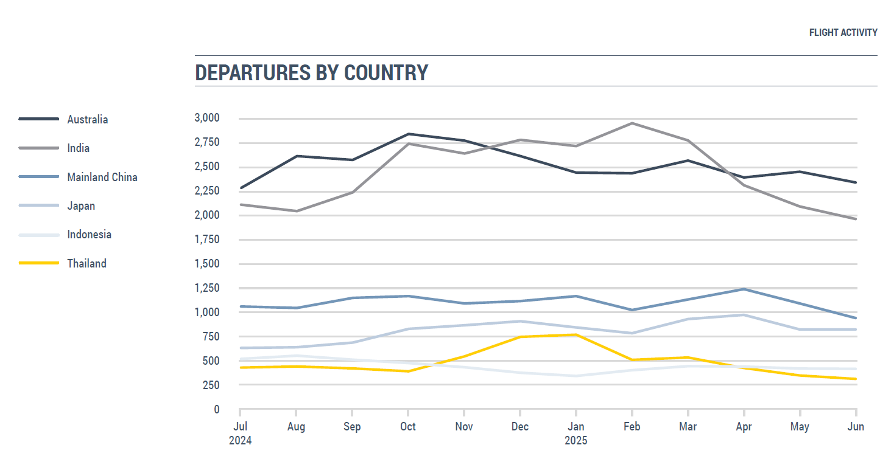
Source: Beijing Business Aviation Association’s CBAI Key Data Research Report 2023
Mainland China
Ownership has declined during the past 4 consecutive years
21.5% market share to lead the APAC market
Flight Activity
Infrastructure
YE | No. of Jet | YOY
2019 | 331 | -
2020 | 346 | +4.53%
2021 | 339 | -2.02%
2022 | 281 | -17.11%
2023 | 270 | -3.91%
2024 | 249 | -7.78%
Departures by Country: Top 3
Stabilized from July 2024 to April 2025
Dropped below 1,000 departures in May and June 2025
Departure by City: Beijing (Top 9) and Shanghai (Top 10)
Beijing’s average monthly departures: 198
Shanghai’s average monthly departures: 171
The growth of FBO and MRO
Source: WINGX’s Asia Pacific Business Jet Flight Activity Q1 2024 Review

Slide 4
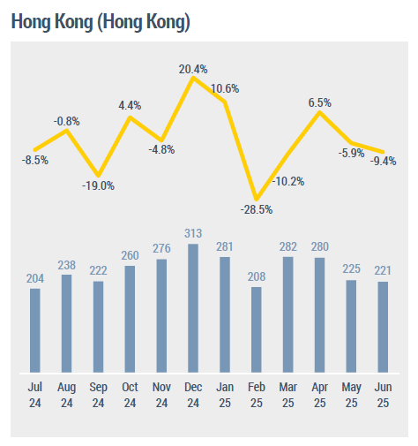
Hong Kong SAR
YE | No. of Jet | YOY
2019 | 121 | -
2020 | 120 | -0.83%
2021 | 99 | -17.5%
2022 | 64 | -35.6%
2023 | 55 | -14.06%
2024 | 56 | +1.81%
Ownership has stabilized after a period of 4 years
Only 4.84% market share the APAC market
Flight Activity
Infrastructure & Supporting
Expansion of HKBAC
Wing-to-Wing Transfer Service initiated by HKIA
World’s third-ranked financial hub (first-ranked in Asia)
Departures by City: Top 6
Average monthly departures: 250
Source: Global Sky Media’s Asia-Pacific Business Jet Fleet 2020-2023

Slide 5
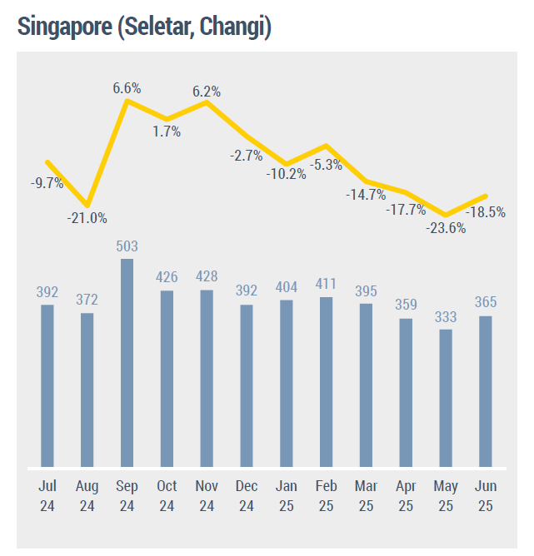
Singapore
Departures by City: Top 3
Average monthly departures: 398
Q2 2025 Top 10 Routes:
1. Singapore – Jakarta
5. Singapore – Kuala Lumpur
YE | No. of Jet | YOY
2019 | 61 | -
2020 | 61 | -
2021 | 63 | +3.28%
2022 | 66 | +4.76%
2023 | 72 | +9.09%
2024 | 83 | +15.28%
Ownership has increased for 4 consecutive years
7.18% market share of the APAC market
Flight Activity
Infrastructure & Supporting
Strong FBO and MRO support with well-established facility
World’s 4th-wealthiest city
Source: Global Sky Media’s Asia-Pacific Business Jet Fleet 2020-2023

Slide 6
YE | No. of Jet | YOY
2019 | 139 | -
2020 | 137 | -1.44%
2021 | 140 | +2.19%
2022 | 144 | +2.86%
2023 | 150 | +4.17%
2024 | 168 | +12%
India
Ownership has increased for 4 consecutive years
14.53% market share of the APAC market
Flight Activity
Departures by Country: Top ½
Departures by City: Mumbai (Top 1) and New Delhi (Top 2)
Mumbai’s average monthly departures: 443
New Delhi’s average monthly departures: 399
Q2 2025 Top 10 Routes: 6/10
Infrastructure & Supporting
A significant no. of airports are expected to be built
Unfavorable tax policy
Excessively protective regulations to local operators
Source: Global Sky Media’s Asia-Pacific Business Jet Fleet 2020-2023

Slide 7





YE | No. of Jet | YOY
2019 | 34 | -
2020 | 34 | -
2021 | 36 | +5.88%
2022 | 39 | +8.33%
2023 | 41 | +5.13%
2024 | 43 | +4.88%
YE | No. of Jet | YOY
2019 | - | -
2020 | - | -
2021 | - | -
2022 | 2 | -
2023 | 6 | +200%
2024 | 8 | +33. 3%
YE | No. of Jet | YOY
2019 | 63 | -
2020 | 57 | -9.52%
2021 | 50 | -12.28%
2022 | 49 | -2%
2023 | 45 | -8.16%
2024 | 39 | -13.3%
YE | No. of Jet | YOY
2019 | 49 | -
2020 | 48 | -2.04%
2021 | 48 | -
2022 | 52 | +8.33%
2023 | 53 | +1.92%
2024 | 57 | +7.55%
YE | No. of Jet | YOY
2019 | 7 | -
2020 | 5 | -28.57%
2021 | 8 | +60%
2022 | 10 | +25%
2023 | 8 | -20%
2024 | 9 | +12.5%
South-east Asia

Slide 8


YE | No. of Jet | YOY
2019 | 63 | -
2020 | 57 | -9.52%
2021 | 65 | +14.04%
2022 | 76 | +16.92%
2023 | 81 | +6.58%
2024 | 81 | -
YE | No. of Jet | YOY
2019 | 21 | -
2020 | 17 | -19.05%
2021 | 20 | +17.65%
2022 | 20 | -
2023 | 23 | +15%
2024 | 22 | -4.35%
East Asia
Source: Asian Sky Media’s Fleet Report 2024

Slide 9
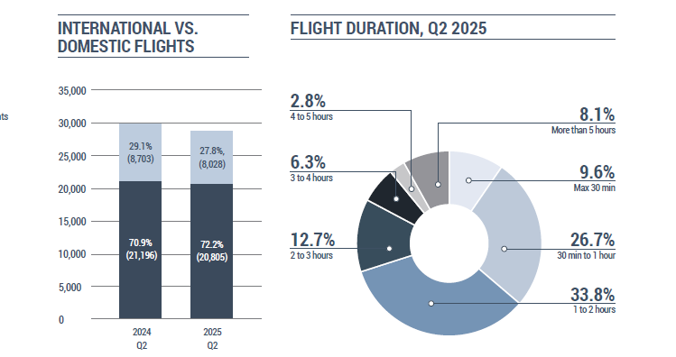

Flight Pattern
Source: Asian Sky Media’s Quarter Report Q2 2025

Slide 10
Change of Aircraft Size
Very Light Jet: -
Light Jet: +
Medium Jet: -
Large Jet: -
Long Range Jet: +
Airliner: +

Slide 11
Summary
Market Opportunity
Continuous slight increase in APAC market
Spotlight on expanding economies
Fleet Number
Promising growth in fleet sizes despite previous setback
Flight Activity
Short-haul/ domestic flights have gained popularity
Jet Size
Markets by country require different body type aircraft due to travel needs

Slide 12
Q & A

