Slide 1
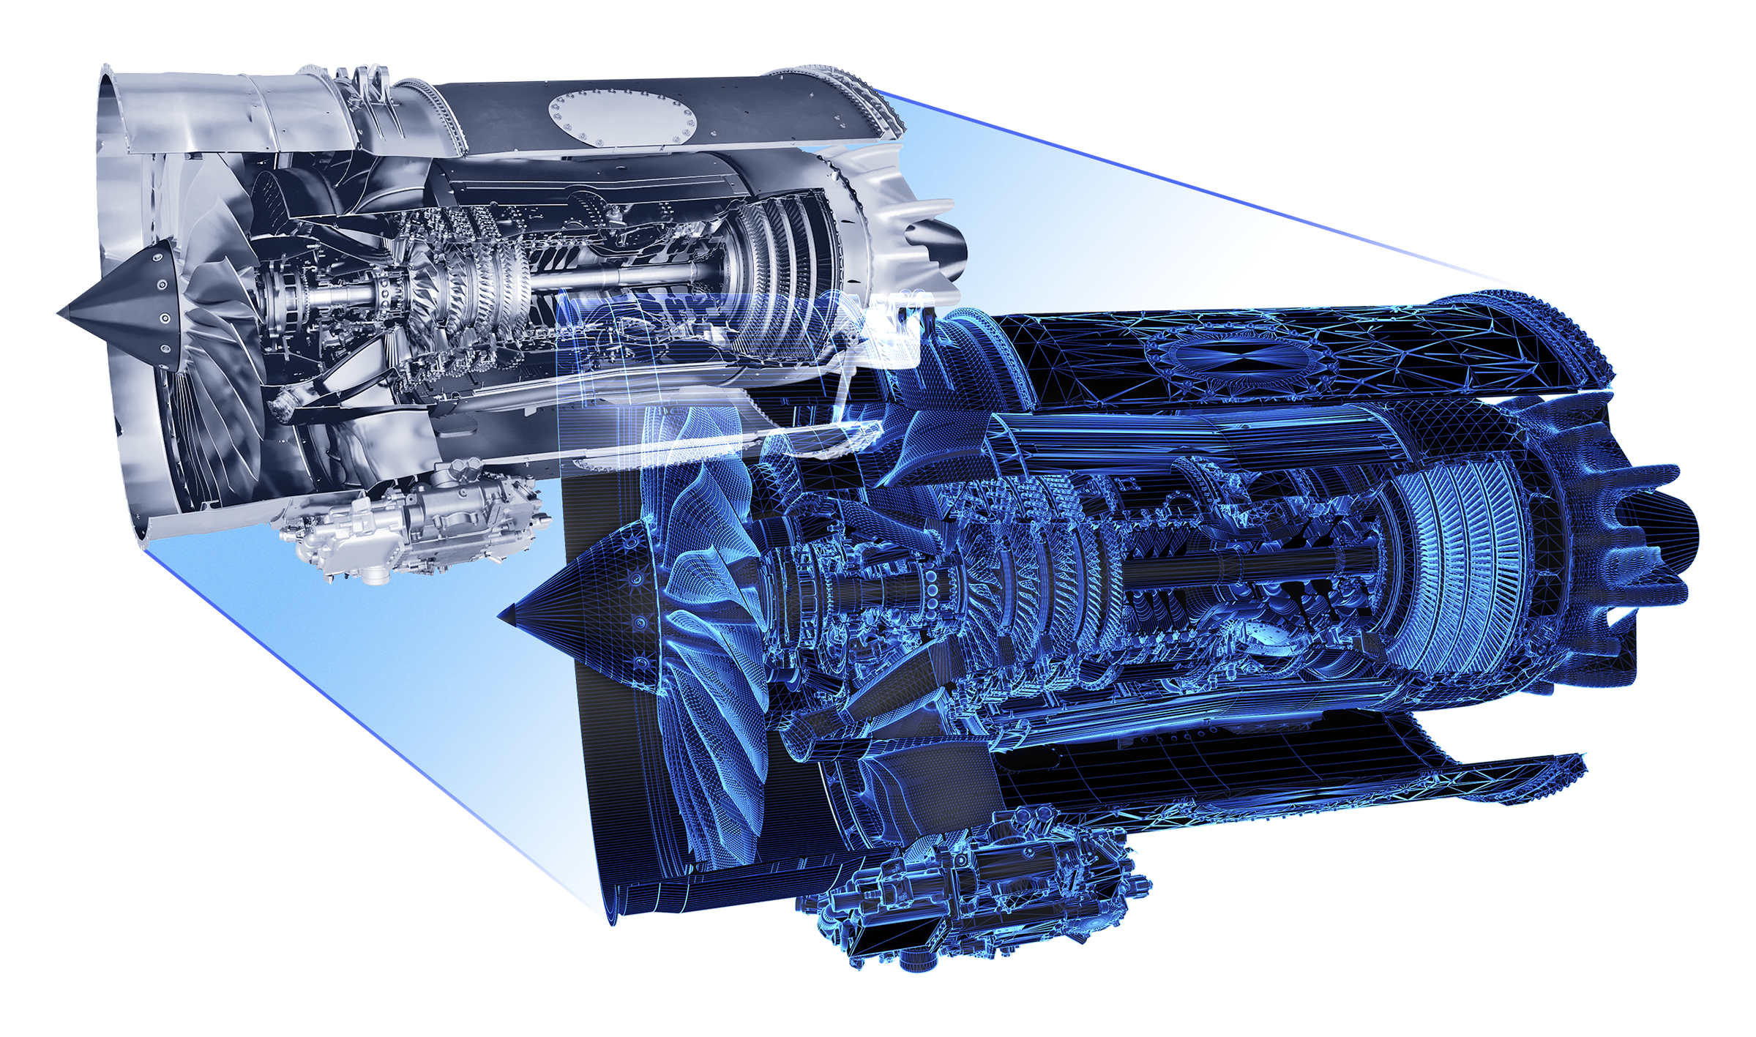
The Power of
Engine Health Monitoring (EHM)
Mark Webster, Rolls-Royce Customer Account Director
The information in this document is proprietary and confidential to Rolls-Royce and is available to authorised recipients only - copying and onward distribution is prohibited other than for the purpose for which it was made available.
Rolls-Royce content only

Slide 2

How has AI engine monitoring evolved over the last 10 years?
Making your data work for you
Private | © 2024 Rolls-Royce | Not Subject to Export Control
Notes:
Opening
Over the past 10 years, AI-driven engine monitoring has changed dramatically.
At Rolls-Royce, we often say: a business aircraft is the owner’s time machine—because time really is money.
Framing the “What if” questions
What if you could get more time on wing—based on your specific engine data?
What if we could foresee an engine issue—and prevent a flight disruption before it happens?
What if you could control the timing of maintenance—balancing operational needs with risk management?
That’s what we’re working to make a reality.
Transition
In the next few minutes, I’ll show you what our current monitoring capabilities look like—and how we’re designing for an even smarter future.
Purpose of Engine Health Monitoring (EHM)
We collect data from all our engines—not just to understand current health, but to predict potential issues.
The goal: avoid interruptions for operators and prepare better when issues arise.
Beyond operations, this data also informs the design of future products—improving reliability and efficiency.
To do this, we combine fleet data, climate data, and advanced digital twin models.

Slide 3
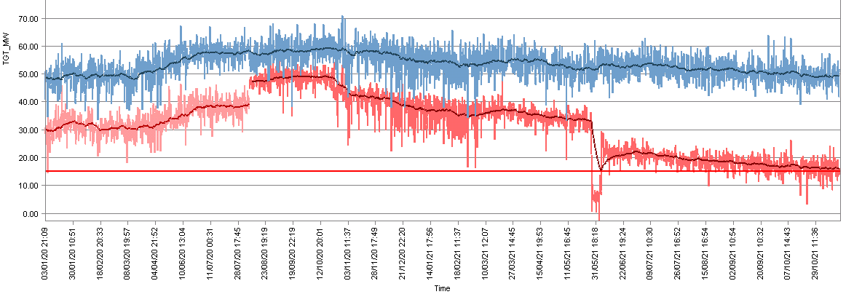
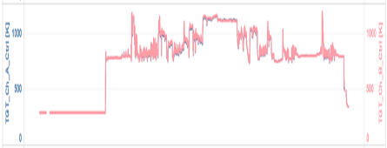
Snapshot Data
Compare LH & RH engine
One data point per flight
High degree of scatter
Good for step change, or long-term trending
Data Fidelity Comparison
Example: TGT Measurement
Multiple Flights
Continuous Data
Compare EEC CHA & CHB
One data point per second
High degree of detail
Good for early emerging problem detection
Single Flight
Notes:
How it started—10 years ago
Back then, EHM relied heavily on pilots spotting and reporting an engine trend shift—often after an exceedance.
Technically, we could only monitor a handful of parameters.
Snapshots were taken at take-off and cruise, then downloaded monthly and emailed to our EHM team for analysis.
Later, some aircraft could send snapshots automatically—but only on the ground, and only if the avionics allowed.
The shift to continuous data
A breakthrough came with the BR725: continuous monitoring.
At 10Hz, we started receiving hundreds of data points every second of flight.
Data was automatically sent on the ground via Wi-Fi - far richer and more frequent than before.
Next Slide

Slide 4
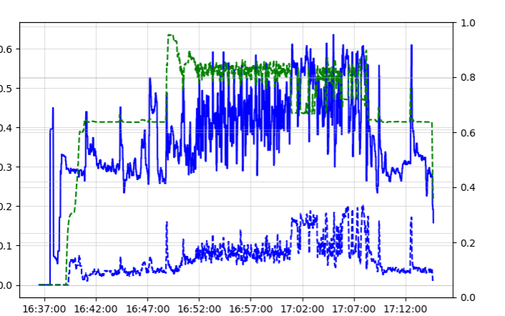
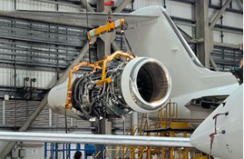
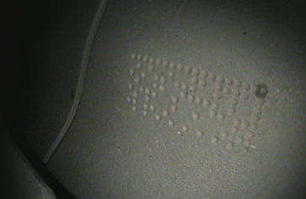
Early Detection & Response
Detection & Response
Return To Service Workstream
Root Cause Investigation Workstream
Failed stage 1 High Pressure Turbine blade
Day 1
8:24 - EHM alert received
9:04 - Proposal to contact customer
11:12 - Operational Service Desk notified
17:30 - On-wing Services arrives on site
18:13 - Notification of HPT 1 blade missing
18:28 - First photo
19:04 - Lease engine allocated
Logistics managed by Operational Service Desk
Lease engine installed by On-wing Services
Aircraft RTS within 1 week of initial alert
Early Details
Borescope fidelity
Part identification (code on blade)
Engineering Support
Experience
GAC engineering briefed
Notes:
Current Capability using Continuous data EHM (BR725 engine)
Aircraft completed the flight, and data auto-uploaded to RR once in the hangar.
Algorithms (AI) detected a parameter shift, and flagged the RRD Engineer who determined we need to look at this engine
Contacted DOM first thing in the morning, asking whether we could send a technician

Slide 5
Standard EHM
Capability | Description | BR710 | BR725 | Pearl
Snapshot data | Fixed flight profile points: in-flight | ✓ | ✓ | ✓
Event data | Event triggered snapshots: in-flight | ✓ | ✓ | ✓
Continuous data (1-10Hz) | Entire flight: on-ground |  | ✓ | ✓
EEC Fault Messages | EEC status and maint. words: on-ground |  | ✓ | ✓
LRU continuous data | Entire flight: on-ground |  |  | ✓
2-Way Communications | Reconfigure data transmitted: on-ground |  |  | ✓
HF Vibration Data | Entire flight: on-ground |  |  | ✓
Live Streaming ground runs | Real-time: on-ground |  |  | ✓
Enhanced EHM
(with AHTMS)
✓ Available capability ✓ Developing capability
Notes:
Today—with Pearl engines
The Pearl family brings a step-change in EHM capability—driven by our IntelligentEngine vision.
With the EVHMU—engine vibration and health monitoring unit—we’ve fused product and service into a digitally enabled solution.
It connects to the Internet of Things and gives instant access to around 10,000 engine health parameters, with unmatched data quality.
Service only available to our CorporateCare Enhanced customers who enrol into the airframers Aircraft Health Monitoring service
Impact and future
Once the aircraft lands, data can be live-streamed.
This enables early detection of emerging issues—avoiding schedule disruptions.
But it’s not only about today’s operations. The same data also feeds into designing the next generation of engines: more efficient, higher-performing, and more resilient.
Close
So, in just 10 years, we’ve gone from monthly snapshots to continuous live-streaming.
That’s the evolution of AI engine monitoring—and it’s only the beginning.

Slide 6
How are OEMs using AI to identify issues or improve operations
Making your data work for you
Private | © 2024 Rolls-Royce | Not Subject to Export Control
Notes:
How are OEMs using AI to either identify individual aircraft / fleet issues, or improve operations?
Opening
Question: How are OEMs using AI to identify issues or improve operations?
At Rolls-Royce, the answer lies in data—collecting, analyzing, and applying it intelligently.
Purpose of data collection
We gather data from every engine in service.
Use it to:
Assess current health
Predict potential issues
Avoid operator interruptions
Prepare better for maintenance events
Beyond today, this data helps us design future engines with improved reliability and efficiency.
Achieved by combining fleet data, climate data, and complex digital twin models.

Slide 7
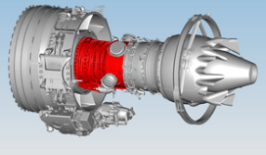
EHM Use Case
HP compressor degradation detection
EHM
Capability
Detection
Level
Detection
Capability
No
EHM
Whole Engine
TGT
increase
(
cockpit
indication
Responding
Preventing
)
Engine Sub
-
Snapshot Data
System
HPC efficiency deterioration
(steady state)
Continuous
Compressor
Sub
-
System
VSV
mechanism
response
time
Data
(transient)
LRU
Continuous
Component
VSV
actuator
current
increase
Data
(transient)
Notes:
Pearl family & IntelligentEngine vision
Pearl engines expand our Engine Health Monitoring (EHM) capabilities.
Part of our IntelligentEngine vision: products and services seamlessly connected through digital.
The EVHMU—engine vibration and health monitoring unit—embodies this vision.
EVHMU = “on-wing intelligence” → supercharged by AI and digital tools.
EVHMU capabilities
Internet-of-Things -enabled, instant access to ~10,000 performance and health parameters.
Data quality far beyond past generations.
Monitors pressure, temperature, vibration, and for the first time, Line Replaceable Units (LRUs).
This means components like fuel pumps can be removed pre-emptively—before they disrupt a flight.
Operational impact
Continuous data can be live-streamed once aircraft is on ground.
Enables early detection of emerging issues.
Supports Rolls-Royce engineers in making fast, data-driven decisions.
Helps operators avoid costly flight delays or cancellations.
Future benefits
The same data feeds back into engine design → higher efficiency, better performance, fewer issues.
EVHMU = transformative step in predictive maintenance, especially in business aviation.
Owners can tap into OEM spare parts and lease networks—e.g., 350,000 spares, 250+ lease engines/nacelles globally.
Close
EHM has been central to this progress.
With AI and monitoring advances, we are moving closer to the ultimate goal: 100% operational availability.

Slide 8
How are you using AI to shape the industry over the next 10 years?
Making your data work for you
Private | © 2024 Rolls-Royce | Not Subject to Export Control
Notes:
How are you using AI to shape the industry over the next 10 years?
Opening
Rolls-Royce is on a bold transformation journey.
Aim: become high-performing, competitive, resilient, and growing.
Digital and AI are at the very core.
Already delivering value today—but the next 10 years will unlock even more.
How Digital & AI Are Creating Impact
Faster, More Efficient Design
Model-based systems engineering + AI-driven automation speeding up design.
Cuts manual work → faster time to market.
Data-driven engineering improves performance and efficiency.
Smarter, More Agile Manufacturing
Example: Signature Analyzer → AI-powered inspection of turbine blade cooling holes.
Boosted machine utilization by 30%.
Cut scrap.
Delivered £24 million in efficiency gains.
Digitally connected machines optimize scheduling + inventory.
Predictive analytics → less downtime, more precision.
Empowering Our People
AI augments, not replaces, human expertise.
Equipping teams with digital tools for faster decision-making.
Streamlines operations, enhances product performance, and strengthens customer support.

Slide 9

Engine Network
Customer & Fleet Management
RRC & MRO
Connected systems
Integrated data
Parts
Availability
Finance
Business
Notes:
Revolutionizing Operations & Maintenance
AI-driven Engine Health Monitoring tracks ~10,000 parameters in real time.
Predictive maintenance improves reliability, reduces shop visits, minimizes downtime.
Advanced AI algorithms:
Detect parameter shifts.
Compare against fleet trends.
Trigger alerts to 24/7 Business Aviation Aircraft Availability Centre.
Initiate structured response workflow.
AI analyses historic cases, predicts potential damage, and supports decision making.
Helps assign mechanics, plan inspections, and act before disruptions occur.
Across fleets: prevents ~400 unplanned events/year → saves millions + weeks of downtime.

Slide 10
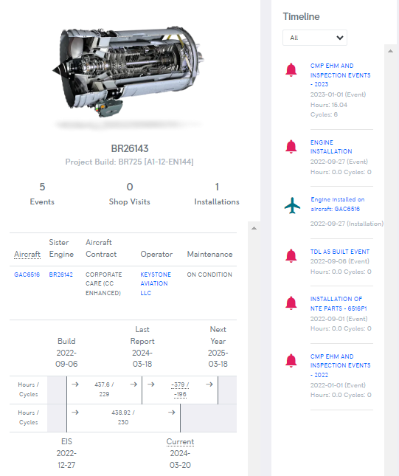
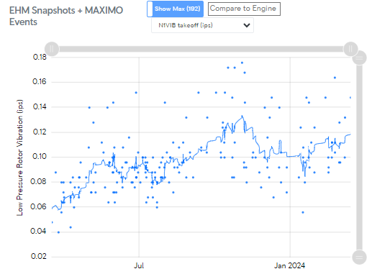
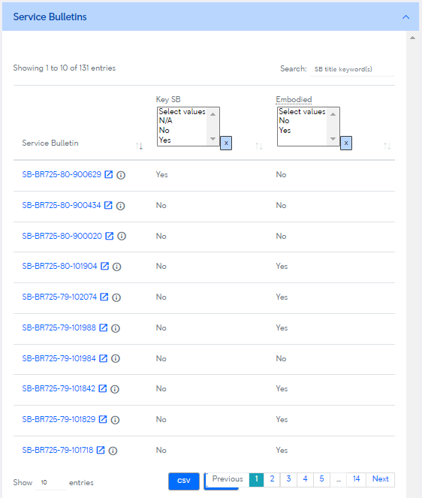
Engine Network Example
Consolidated view from multiple sources
Improved decision making
Notes:
Closing
AI is already reshaping design, manufacturing, maintenance, and customer support.
Over the next 10 years, the impact will only accelerate.
With digital and AI at the heart of our transformation, we’re moving toward a future of greater reliability, efficiency, and customer value.

Slide 11
Notes:
CONCLUSION:
ONLY Rolls-Royce has this data; not just for your engine, but for the entire family, and across all our engine products.
Only Rolls-Royce is equipped to support your engine operations.

