Slide 1
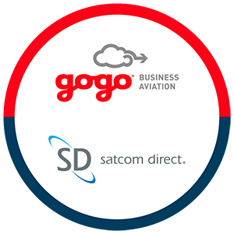
This strategic partnership combines two industry-leading technology companies to
form the only truly global, multi-orbit,
multi-band in-flight connectivity provider.
Notes:
Acquisition of SD was great fit for both companies. GoGo with its ATG services over north America typically servicing the smaller to medium jet market. And SD providing satcom systems to heavier jets, widebodies and VVIP aircrafts globally.
We now service over 11,000 aircrafts in 100 countries
Being the worlds only global, multi band, multi orbit service provider we can tailor solutions to be fit for purpose for any aircraft type, from turbo props to widebodies regardless location and budget.
Galileo

Slide 2
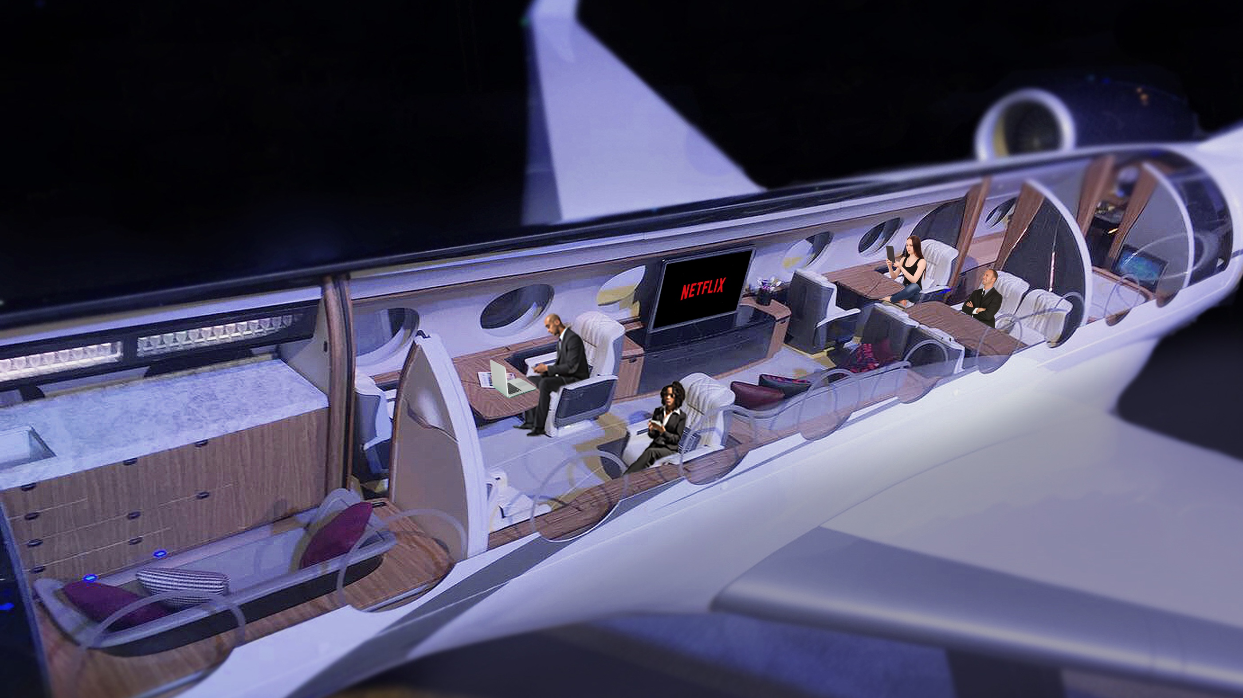







Entertainment & online gaming
Business
Aviation Trends
1.7 GB/Flight hour
95th pct. of demand is 12.5/1.7 Mbps
90th pct. of demand is 4.3/.56 Mbps
2.8GB/Hr
Web Browsing
210MB/Hr
Trading
255MB/Hr
Working in the cloud
1.25GB/Hr
Notes:
We can get a good picture of what our customers need by reviewing usage trends across our fleet.
Applications are becoming more data hungry and video centric.
Netflix, youtube, Disney+ prime etc are growing in popularity and demand but also, business usage of video apps like facetime, teams, whatsapp, Webex and so on.
We know we have access to these apps on the ground but it is very quickly becoming a requirement in the air as well.
Network operators are doing a great job keeping up with this demand and continue to add capacity to match the customers need.
We expect the GEO networks like Viasat/Inmarsat and Intelsat to be providing upwards of 100Mbps in the 1-2 years.
LEO networks however are already capable of providing 200Mbps
With speed and capacity no longer a real issue its about to providing a reliable and consistent service to our customer base (new and existing)

Slide 3
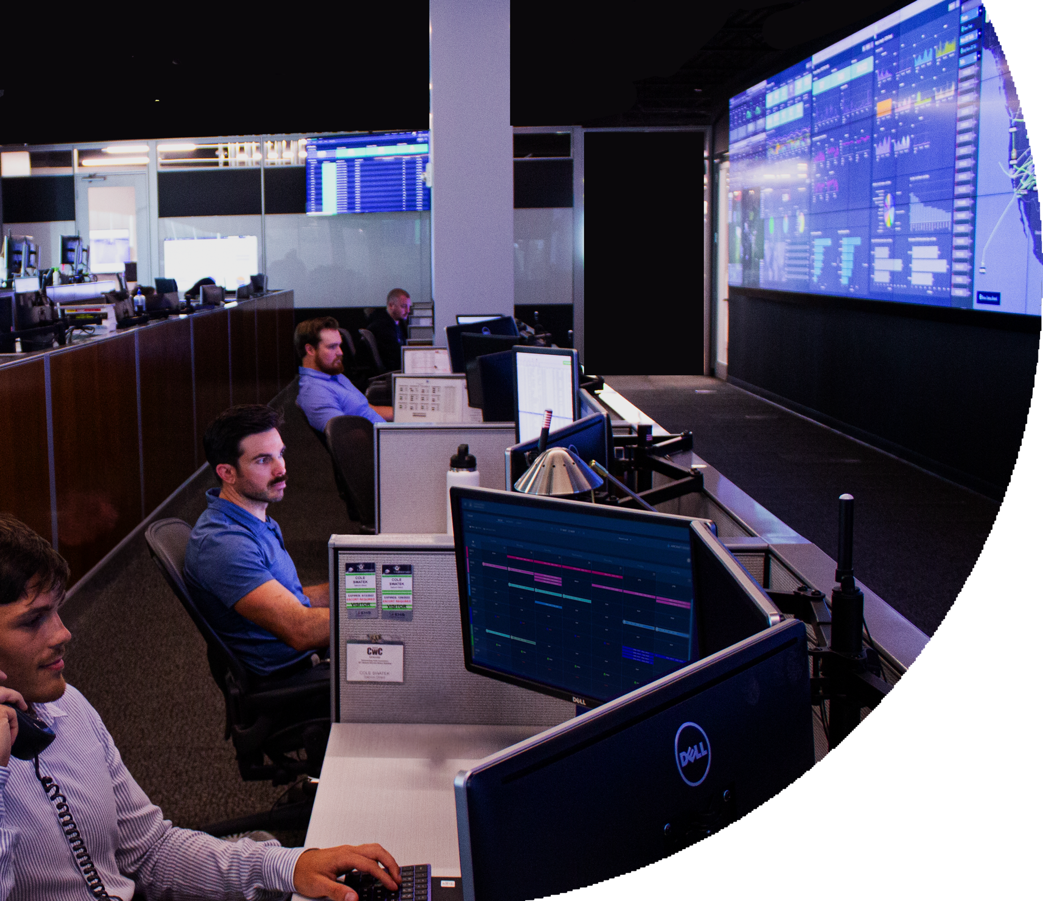





Supporting Value
CONNECTIVITY
BEST IN CLASS
Cabin | Cockpit
HARDWARE
MODULARITY
Multi-band Terminals Harmonized Cabin Network
SOFTWARE
STANDARDS
SD Pro /DASH
Connected Services
Mobile Apps | APIs
INFRASTRUCTURE
Support | Cybersecurity | Data Center
Notes:
Now we have discussed the value that connectivity can bring to your aircraft, now I want to share with you what SP’s like us need to do to support that value and you, via our ecosystem.
Gogo manage that entire ecosystem, from infrastructure, hardware, software and connectivity to ensure reliability across all of these components.
We have built our ecosystem based on 4 pillars:
Connectivity – reliable connectivity across multiple networks
Hardware - We manufacture both the terminals and the routers which we can configure bespoke solutions for charter, owner and VIP operations
Software – we give you access to the data flow to and from the aircraft, wheels up wheels down, data throughput, flight tracking and so on.
Support – our support ethos is to provide fast fault resolution and responsiveness to our customers throughout the world.
Bad options file pushed to aircrafts, within 24 hours the fault was fixed on 97% of aircrafts equipped with SDR’s.
Infrastructure - of course cyber security which as we become more connected cyber attacks become an increasing threat. We are currently blocking over 5K cyber attacks per day across our fleet and we have different levels of threat detection available.
With this ecosystem we hope and strive to provide the best value to our customers across the globe.

Slide 4
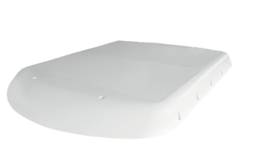
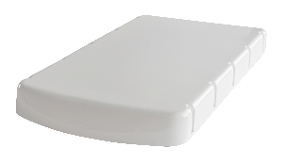
Galileo ESA Antenna
HDX antenna
FDX antenna
Speed: ↓ 60 Mbps down, ↑ 11 Mbps up
Weight: 21.6 lbs
Dimensions: 24” L x 11.8” W x 2.1” H
Performance: 43 - 60 Mbps
Speed: ↓ 195 Mbps down, ↑ 32 Mbps up
Weight: 40 - 45 lbs
Dimensions: 30" L x 24.6" W x 2.1” H
Performance: 145 - 195 Mbps

