Slide 1
Aviation Tariffs: Overview, Impacts & Uncertainties
David M. Hernandez, Shareholder
VedderPriceSM
Corporate Jet Investor Asia 2025
October 1, 2025

Slide 2
Background & Legal Authorities
IEEPA (International Emergency Economic Powers Act, 1977): Used to declare a national emergency over fentanyl, the U.S. trade deficit and nonreciprocal treatment in trade, giving authority to impose broad tariffs.
Section 232 of the Trade Expansion Act (1962): national security justification for tariffs on steel, aluminum (~50%), autos, copper, etc.
Section 301 of the Trade Act of 1974: respond to unfair trade practices (e.g. China).
Key dates / declarations:
April 2, 2025: National emergency declared, baseline 10% tariff on all imports, plus “reciprocal tariffs” for countries with large trade deficits or nonreciprocal trade policies. Effective April 5.
Other executive orders, e.g. on goods from countries importing Venezuelan & Russian oil: 25% tariff on India.

Slide 3
Economic & Fiscal Impacts
Federal tariff revenue: ~$165 B (Jan–Aug 2025)
Projected 2026‑2035 revenue: ~$2.9 T
Average effective tariff rate: from ~2‑3% to ~9‑10% mid‑2025
GDP growth impact: approx −0.9 pp in 2025
Long‑run output: ~‑0.6%

Slide 4
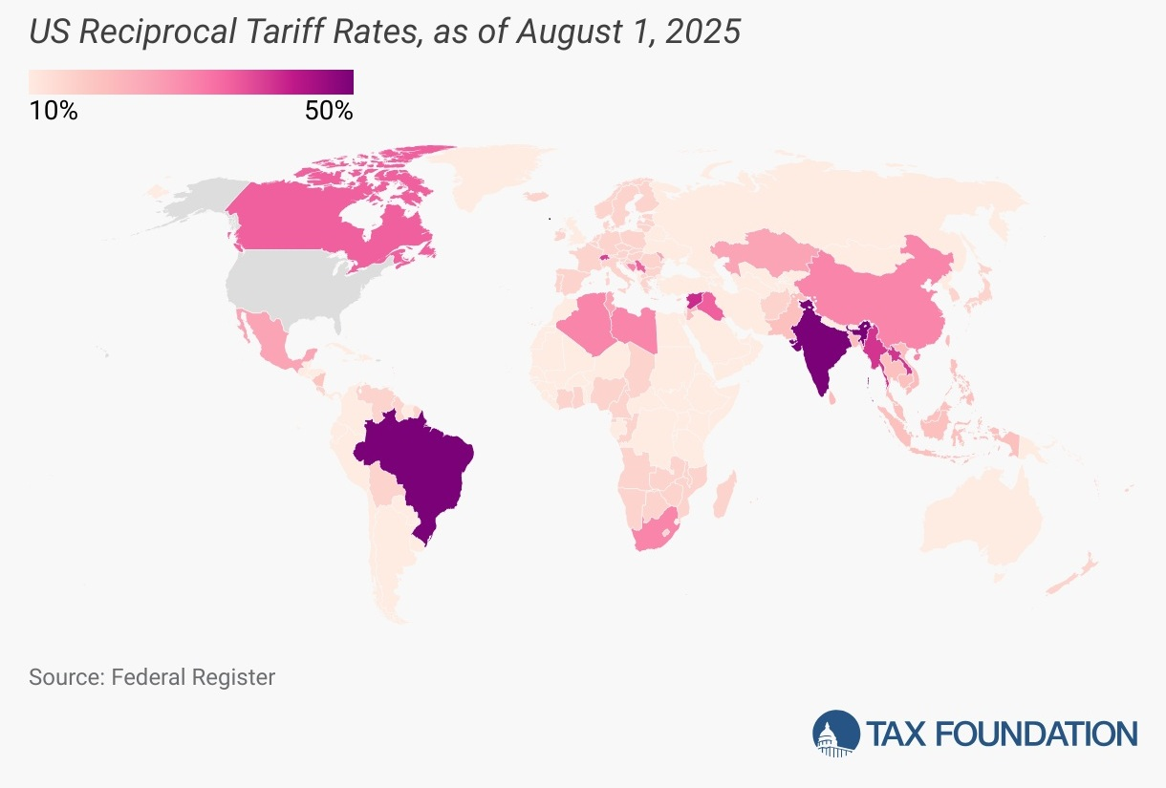

U.S. Reciprocal Tariff Rates

Slide 5
Aviation Impact & Uncertainties
Zero-for-zero agreement with EU & UK: aircraft and aircraft parts traded between U.S. and EU & UK are exempt from the tariffs that had been imposed earlier.
Section 232 investigation into commercial aircraft, jet engines and parts. If that leads to new tariffs under “national security” justification, costs may escalate further.
Trade and Delivery Disruptions: OEMs, MROs and suppliers have raised concerns about delayed or deferred deliveries and maintenance.

Slide 6
Aviation Impact & Uncertainties
Pilatus has been severely impacted. August 7th, U.S imposed an approx. 39% tariff on Swiss goods, including the PC-12 and PC-24 aircraft. August 8th, Pilatus halted deliveries to the U.S. (40% of its market).
Canadian & Mexican Non-USMCA compliant aircraft, engines and parts are subject to 25% tariffs; need to review whether the aircraft was exported out of the USMCA customs control or substantially transformed.
Brazil aviation/aerospace subject to 10% tariffs; nominal tariff rate is 50% under IEEPA due to “national security concerns.”

Slide 7
Aviation Impact & Uncertainties
Aftermarket suppliers rely on importing many spare components, tools, materials. Tariffs raise cost of imported parts. Lead times and certification create bottlenecks concerns are increasing.
Increased maintenance cost; possibly delays in maintenance; MROs may need to stock more inventory (which ties up capital) to buffer against delays; increasing potential disruptions or counterfeit parts.
MROs passing costs on to customers, delayed PPIs and maintenance.

Slide 8
International & Trade‑Retaliation/Effects
Retaliatory tariffs by key partners (e.g., China, EU)
Swiss exports to U.S. down over 20% after tariffs
Trade diversion to untariffed countries
Investments in U.S. supply chain, supplier capacity, and possibly reshoring may accelerate due to tariff pressure, but establishing capacity takes time, investment, and meeting certification requirements.
Pilatus exploring U.S. manufacturing.
Will Embraer expand its U.S. manufacturing?

Slide 9
Legal Challenges & Uncertainties
Federal courts have ruled some IEEPA-based tariffs illegal; but many remain in effect pending appeals.
The stacking of tariffs raises questions of fairness, legality, and administrative complexity.
U.S. Supreme Court to review in November.
How do you refund $300 billion & to whom?
Exemptions and delays create uncertainty for businesses trying to plan.
What happens in 2026 and 2028 ?

Slide 10
Thank you & Questions
David M. Hernandez, Shareholder
Business Aviation and Regulation Sub-Practice Chair
VedderPriceSM
1401 New York Ave. NW, Suite 500
Washington, DC 20005
T +1 202 312 3340 | M +1 202 403 1678
dhernandez@veddeprice.com
www.vedderprice.com

