Slide 1

Legal and risk developments that will affect your business
Peter Coles, FRAeS
Partner, HFW London
CJI Malta
11th June 2025

Slide 2


Slide 3

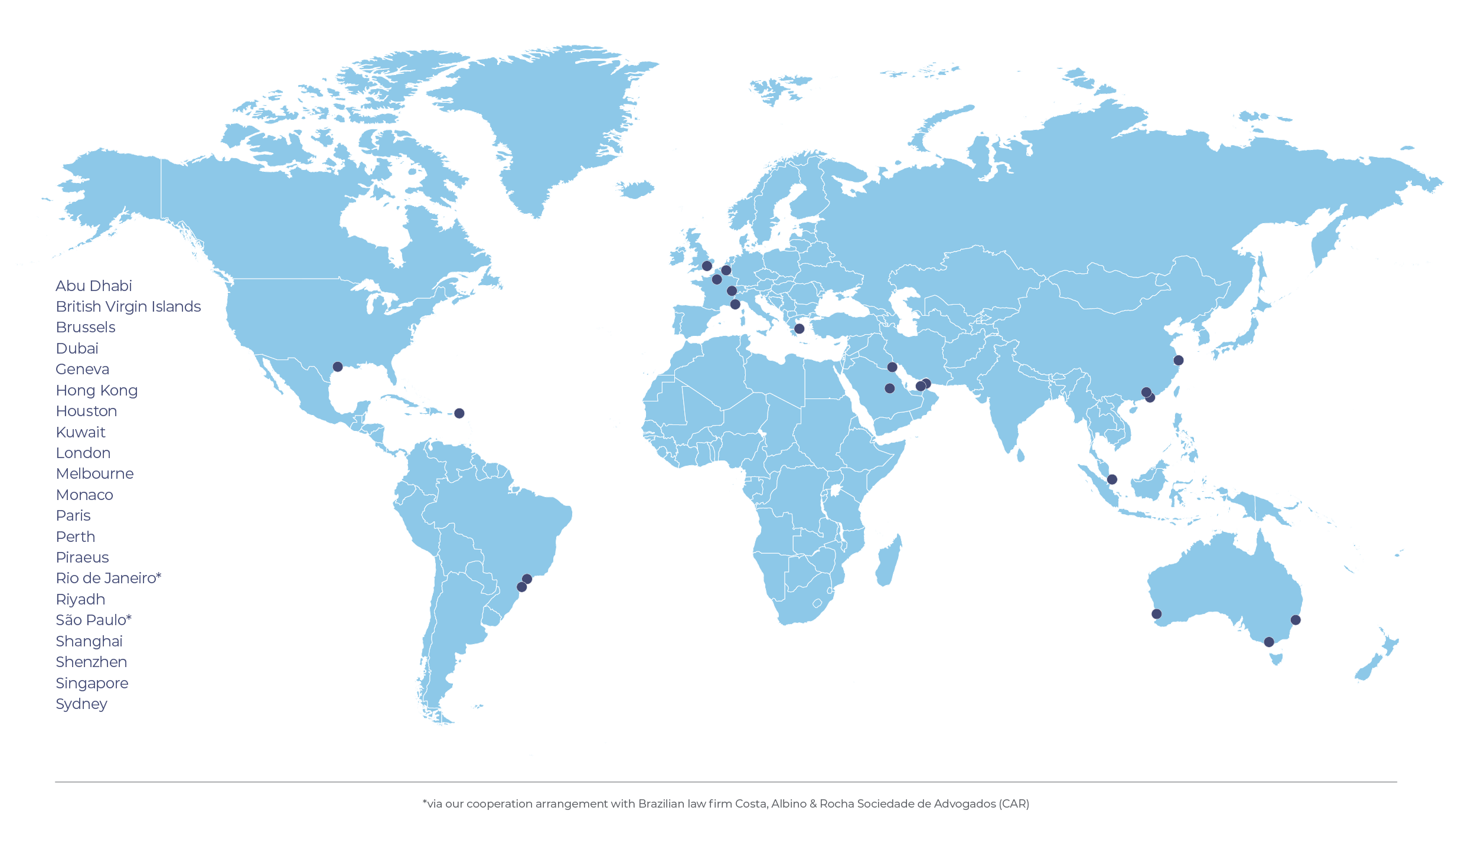


WHY CHOOSE HFW
80+
Aviation Lawyers
We are proud to serve the aerospace industry with a dedicated, full-service team worldwide.
Full suite of services,
24 hours a day.
Clients are from all spheres of the industry.
4+
Decades of service to the aviation industry.
12
Offices with aerospace specialists spread across Americas, Europe, Middle East and Asia Pacific.
Consistently ranked as a Tier 1 Firm
3

Slide 4

OUR expertise
Aviation regulation
Compliance – H&S, sanctions, privacy, ESG
Corporate & commercial
Employment
Purchase, sale, finance and leasing
Aviation insurance
Contingency planning and emergency response
Claims & recoveries
Commercial disputes
Enforcement

Slide 5
challenges
“At CJI in London, the mood was plain: whether it’s scheduling maintenance, sourcing parts, or getting technicians in place, the whole system feels out of sync.”
Martyn Fiddler
Environment
Data and cyberbreaches
Geopolitics
Safety
Delayed aircraft
Defective aircraft
Cost of overhauls and maintenance
Lack of spare parts
Skills shortages
Regulatory hurdles and taxes
“

Slide 6
Importance of case law: EVOLUTION OF THE LAW
Precedential value in the UK and in other common law jurisdictions (e.g. Australia, Canada, USA, India, Malaysia, Singapore, Hong Kong). Also important in civil law jurisdictions.
Maybe binding or influential. Judges follow decisions of higher courts or take them into consideration.
Provides predictability and consistency. Although cases may be distinguished on their facts and the law evolves through time.
Helps to shape legal doctrines and principles.
Decisions can be adapted (flexible) and extended to reflect changes in business and society.
Informing understanding of (i) how legal guidelines work in a particular jurisdiction and (ii) what are (un) acceptable business practices.
IMPACTS TEMPLATES, AGREEMENTS, CHECK LISTS, MANUALS, GUIDANCE, INDUSTRY PRACTICES, THE LAW

Slide 7

Grand Aero Theft: Russia & Ukraine
“RUSSIA MAY HAVE COMMITTED THE LARGEST THEFT of AIRCRAFT IN HISTORY “
Invasion of Ukraine in February 2022 triggered sanctions. Inability:
Fly to, from and over Russia
Finance aircraft and parts
Lease aircraft
Supply parts
Maintain aircraft and parts
Provide insurance
Leases terminated. Aircraft not returned.
Aircraft stranded in Ukraine due to war.
How should insurance respond?

Slide 8
Grand Aero Theft
why these cases matter to you?
‘Grand Theft Aero’: Russia’s $10bn plane grab signals losses for lessors
FINANCIAL TIMES
“Russia’s stolen planes will become worthless thanks to bootleg parts”.
“Multibillion-pound ‘Mega Trial’ over hundreds of aircraft stranded in Russia”
LAW SOCIETY
Post invasion sanctions impacted corporate and private jets
Some still stranded. Disputes concerning unpaid bills.
Highlight importance of:
continuous due diligence
recovery protocols
contract terms
availability of insurance
Even in the absence of wars, jets and helicopters have been detained etc for long periods

Slide 9
WHY HAVE AN EXCLUSIVE JURISDICTION CLAUSE?
Three principal reasons for specifying which forum has jurisdiction.
Convenience. You may well want to sue or be sued in the country/territory in which you are based.
A preferred judicial system: if you are the party most likely to sue (e.g. a purchaser or lender) then you will want any dispute to be heard in a jurisdiction which has an efficient judicial system and offers a good range of interim and final remedies.
Enforcement: the commercial worth of a judgment depends on its enforceability and the location of the defendant's assets needs to be taken into account.

Slide 10
Reasons to uphold exclusive jurisdiction clause
In most, but not all, cases the courts of England will give effect to a jurisdiction clause vesting jurisdiction in them or in the courts of another state.
The strong policy reasons include:
Recognition of the freedom of parties to contract as they wish.
The interest of justice and the courts may be served by holding parties to their bargain.
Commercial certainty.
Local law in certain common and civil law jurisdictions may also require that courts give effect to them.

Slide 11
CIRCUMSTANCES WHERE A EJC MAY NOT be upheld
However, they do not always give effect to jurisdiction clauses:
where the clause is poorly drafted / ambiguous;
the "battle of forms" - not clear on which terms the parties have contracted;
where, since agreeing the clause, some factor that could not have been foreseen at the time the bargain was struck has occurred;
where rules of jurisdiction provide that certain disputes have to be decided by certain courts;
where the clause is non-exclusive and the other party initiates proceedings in another state;
where there are “strong reasons” (policy reasons underly the test) not to do so.

Slide 12
CIRCUMSTANCES WHERE A EJC MAY NOT be upheld
Strong reasons test considerations:
the location of evidence
whether the law of the foreign court applies and, if so, how it differs from English law
the relative convenience and expense of trial between England and the foreign country
the connections of the parties with either country
whether defendants genuinely desire trial in a foreign country or are only seeking procedural advantages
whether claimants would be prejudiced by having to sue in the foreign court because, among other things, they would be unlikely to get a fair trial.
Consequences of war capable of being strong reasons to decline a stay as may make it unreasonable to hold a party to a bargain.
English courts will not enforce or recognise a right or legal relationship arising under the law of a foreign country, if this would be inconsistent with fundamental public policy of English law.

Slide 13
Case law 2024: : exclusive jurisdiction clauses
Majority of reinsurance policies contained governing law clauses applying Russian or Ukrainian law and exclusive jurisdiction clauses requiring the resolution of disputes in Russia and Ukraine. These were challenged.
Zephyrus Capital Aviation Partners 1d Limited And Others - and - Fidelis Underwriting Limited And Others 28th March 2024
Russian Operator Claims. Lessors won. London Commercial Court has jurisdiction to hear claims, but they remain governed by Russian law.
Key issues: likelihood of a fair trial, state interference.
Aercap Ireland Capital Designated Activity Company and others - and - PJSC Insurance Company Universalna and others 6th June 2024
Ukraine Operator Claims. Defendant reinsurers won. Proceedings need to be issued in Ukraine. Ukrainian law governs.
Key issue: war and ability of cases to proceed in Ukraine.

Slide 14
Risk management
Always best to:
Include a jurisdiction clause in a contract.
Ensure that both parties have agreed to it.
Periodically review their appropriateness, particularly given the evolution of international politics and events and what may constitute public policy. Make a record of the assessment.
Act quickly if a party issues proceedings in another court / jurisdiction:
Disagreement as to venue must be resolved first and the court / tribunal should be made aware of your disagreement as soon as possible.
A party may lose a claim to equitable relief by slowness, procrastination or unconscionable conduct.

Slide 15
Mega trial - Common Points Yet To be Judged
Which reinsurance should respond: Contingency, Operator. AR & WR.
Operators Cover
Russian law approach to contracts and insurance
Lessors’ status in insurance and reinsurance policies, given governing law
Have losses or damage arisen?
Does a primary insured (airline) have to suffer loss/damage for a Lessor to benefit from its hull insurance
Did a loss arise by virtue of a peril insured against
Does a loss arise where an operator declines to return an aircraft
Whether Lessors have a right to recover directly from Reinsurers under a Cut-Through Clause
Impact of sanctions : on policy coverage and payments
Considerations - Checklists for In-House Counsel, Insurance Teams and CRO
Normal checks. Heightened attention – advanced scrutiny
What?
Agreements, key terms, obligations of broker, schedules, governing law and jurisdiction
Insurance and Insurance Certificate wording
Reinsurance arrangements
Regulations

Slide 16
Ground handling AGREEMENTS
UNDER REVIEW
QUOTES
Various ground handling agreements in use since 1993 (IATA, IBAC, ACI)
By far the most used is the IATA standard, piecemeal updates every 5 years
Is it still fit for purpose?
Cost of ground damage incidents rising
Aircraft are more complex and expensive to repair. Are the limits appropriate?
Operators are exposed to greater uninsured financial exposures
Growth of independent ground handlers, better able to manage risks in operations and purchase adequate insurance cover
“The Standard IATA Ground handling Agreement is a dog’s breakfast”
AIRLINE GENERAL COUNSEL
“Article 8 is manifestly unfair “
FBO RISK MANAGER

Slide 17
Risk Allocation – operator and Handler
Handler protection - Articles 8.1 (a) to (d) (passenger injury, death, baggage, cargo; property):
Operator not permitted to make a claim against handler
Operator required to indemnify handler against any “legal liability for claims or suits” and “costs and expenses”
Designed to be read together with a sweep up exclusion of “any consequential loss or damage”.
Exceptions
Handler required to indemnify Operator for:
Direct loss of or damage to cargo caused by Handler’s negligence. Rely on MC99 limits. Overall cap of USD1 million. [Sub-Article 8.6]
Physical loss and damage to aircraft caused by Handler’s negligence. Limit based on hull deductible. Maximum USD 1.5 million. [Sub-Article 8.5]
Sub-Article 8.1 bad behaviour - where damage, death, delay, injury or loss etc caused by Handler’s:
intending to cause damage etc or
“recklessly and with the knowledge that damage…would probably result”
If these apply, then handler’s liability unlimited but no obligation to indemnify Operator

Slide 18
Legal Issues: liabilities & indemnities
Leakage
Liability terms appearing in Annexes and SLAs. Should be in one place.
Does Article 8 address all liabilities that operators and handlers may have?
What about purely commercial losses where the events and claims in it do not arise?
What about fines?
Indemnities
Valid / invalid under local law?
When are they triggered? When is “legal liability” established?
What are “costs and expenses incidental thereto”? Are the cost of surveyors and lawyers recoverable?
When can the indemnities be withdrawn?
How define recklessness etc? Subjective / objective approach?

Slide 19
Potential losses – Aircraft Damage
Protecting passengers onto other flights, including HOTAC
Cost of crew HOTAC and changes
Cost of rescheduling
AOG team flights, HOTAC
External survey
Actual costs of repairing aircraft on temporary and permanent basis: parts, materials, labour
Handling fees for parts and materials – customs, transportation and storage
Test flights, ferry flights, positioning
Extra parking fees, handling
Leasing / exchange of replacement parts
Internal investigation costs
Compensation paid to Passengers for delay (MC99, EU261 or equivalent)
Loss of priority payloads, spoilt cargo
Compensation to cargo interests
Aircraft finance / leasing charges for aircraft out of service
Charges for chartering alternative aircraft.
Loss of income and profit while aircraft out of service.
Delay and cancellation of flights until suitable replacement aircraft deployed
Diminution in value of the aircraft.
Customs charges for aircraft undergoing maintenance for longer than expected

Slide 20
Legal Issue: What losses are recoverable or not?
What are consequential losses? Different jurisdictions have different approaches
“Direct Loss" – defined in Main Agreement: “Loss arising naturally or directly from an occurrence which excludes remote, indirect, consequential, or special losses or damage such as loss of revenue or loss of profit“.
“Direct loss” does NOT appear in Sub-Article 8.5. It does appear in Sub-Article 8.6 regarding loss / disappearance of cargo.
The 2nd phrase of the definition suggests that loss of revenue and loss of profit cannot be a direct loss. However, that is not correct.
Question?
Is it better to tighten the generic language or have a list of costs and losses?

Slide 21
TASK FORCE REVIEW
Allocation of risk
Seeking to remove ambiguities in contract language over issues like losses
Aviation insurers waiting to see proposals before commenting further
Peter Coles HFW participating

Slide 22

BUYER/OPERATOR & OEM balance
Beware
Constant theme
Delayed deliveries
Defective aircraft
OEM regime
Supply chain problems existed long before Covid19. Excusable and non-excusable delays.
Liabilities and remedies for defective products: repair or replacement. Everything else excluded.
Is the exclusionary language up to date?
Implied terms and durability
“Frustrations with the OEMs are felt right across the board”.
Implied terms and durability

Slide 23
Implied terms
Air Transworld Ltd v Bombardier Inc [2012] EWHC 243 (Comm) ('Bombardier’)
Purchase of new Challenger 605 private jet aircraft.
Within 14 months, aircraft made an unscheduled landing when there was a problem with the main engine driven pump in the hydraulic system which had been powering flight controls.
The Claimant sought a declaration that it had validly rejected the aircraft. Hence, the contract of sale was rescinded, and the purchase price should be refunded. Alternatively, if the Claimant was not entitled to reject, damages should be awarded.
Wilmington Trust SP Services (Dublin) Limited & Ors v Spicejet Limited [2021] EWHC 1117 (Comm) ('Spicejet')
Ten-year dry leases for a B737-800 and two B737-MAX 8.
The Claimants applied for summary judgment for outstanding amounts under the lease agreements.
Among other defences, the Defendant raised that the two MAX 8 aircraft were not of satisfactory quality given the design fault which rendered them liable to crash.

Slide 24
Air Transworld Ltd v Bombardier Inc [2012] EWHC 243
An exclusion clause that does not expressly refer to the word "conditions" is nevertheless successful to exclude the conditions implied into a sale of goods under the Sale of Goods Act 1979.
The first part of the exclusion clause was clear that all the seller's obligations and liabilities were to be found exclusively in the contract, and that general wording excluding obligations implied by law was sufficient to exclude the conditions implied by the SGA.
The express reference in the second part of the exclusion clause to "warranties of merchantability and fitness for purpose" was merely an example of terms implied by law which had been excluded by the first part.

Slide 25
Wilmington Trust SP Services (Dublin) Limited & Ors v Spicejet Limited [2021] EWHC 1117 (Comm) ('Spicejet')
There was no serious dispute that Spicejet had, at the very least, an arguable case on the facts that the two MAX 8 aircraft were not of satisfactory quality for the purposes of SOGSA given a design fault which rendered them liable to crash
Court considered whether the statutory implied condition of satisfactory quality was excluded by the express provisions of the Lease Agreements
It was common ground that the SOGSA implied conditions can only be excluded by language which expressly or necessarily refers to such conditions.
The clause relied on referred only to representations or warranties. Conditions are nowhere mentioned.
A condition of satisfactory quality is not a representation and, as recognised by The Mercini Lady, [2010] EWCA Civ. 1145, wording excluding warranties is not effective to exclude conditions.

Slide 26

conclusions
Aviation industry overly reliant upon what it believes to be standard contracts or clauses.
Contracts need to evolve as legal developments and circumstances evolve. Old contracts are not fit for purpose when facing new challenges.
A “standard market” clause is not standard and can be negotiated away if its no longer justifiable or the party relying on it cannot explain it.
Contract reviews are important, and some insurance bursaries will pay for them or training.

Slide 27
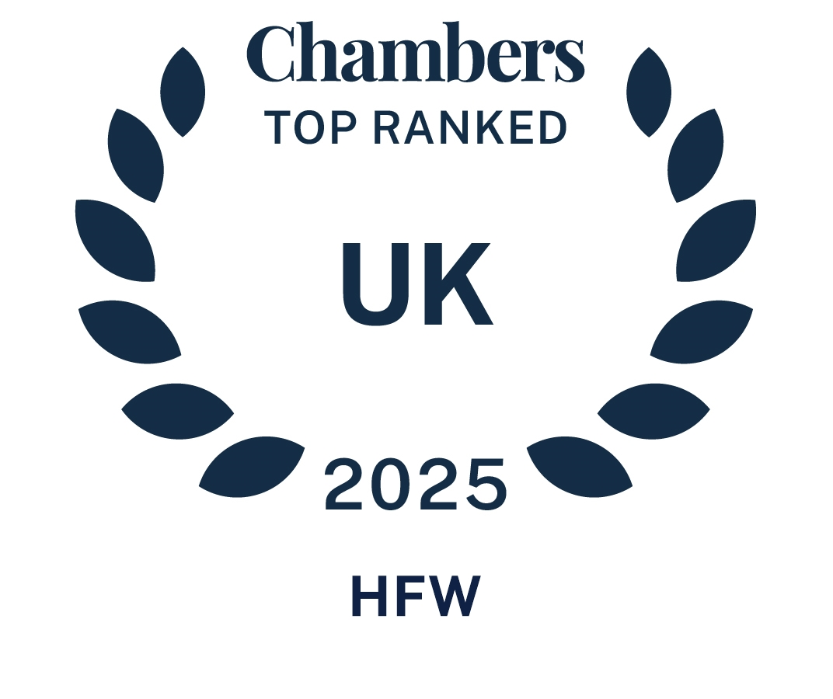
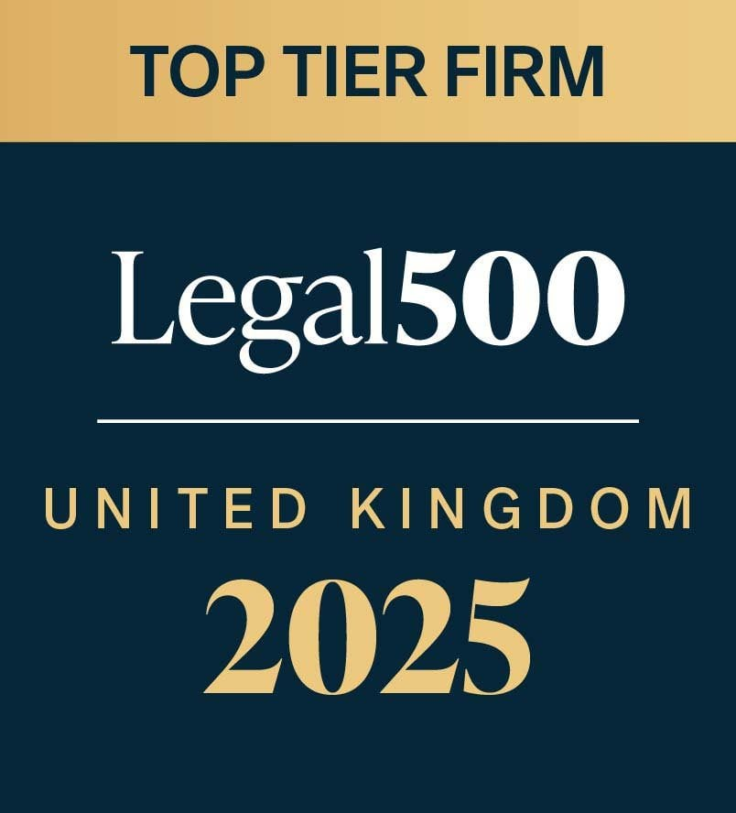
MARKET RECOGNITION
“
“
“
“The whole team always provides urgent advice in a short period of time and sometimes within a day in consideration of different timezones.”
CHAMBERS AND PARTNERS
2025 - AVIATION
“The team has always been a pleasure. They are all very good to work with and their individual knowledge is exceptional.”
LEGAL 500 2025 – AVIATION
“They have deep knowledge of the industry.”
LEGAL 500 2025 – TRANSPORT FINANCE AND LEASING
“
“
“
“They do a great job, are very professional with a lot of experience. They are good in front of clients, have good relationships and are knowledgeable.”
CHAMBERS AND PARTNERS 2025 - AVIATION
“We have always found the firm to be very efficient, professional and all the team have a vast amount of knowledge and expertise in aviation. We would consider using the firm on any new instructions, as well as the fact that they are written into a number of our lead accounts.”
LEGAL 500 2025 - AVIATION
“They are a full-service firm with experienced aviation professionals who have years of experience in all facets including financing, regulatory and leasing structures.”
CHAMBERS AND PARTNERS 2025 – ASSET FINANCE

